Slide 1

JavaꢀProgramming
PresentꢀBy
ꢀꢀꢀꢀꢀPoovaragavanꢀVelumani
ꢀꢀꢀꢀꢀJavaꢀtrainer
ꢀꢀꢀꢀꢀ+91-6385260317
ꢀꢀꢀꢀꢀEmailꢀidꢀ:ꢀmsgtovpragavan@gmail.com

Slide 2

• Javaꢀ&ꢀItsꢀfeatures
• UnderstandingꢀFundamentals
• DifferenceꢀbetweenꢀC,ꢀC++ꢀandꢀJava
• Environmentꢀsetup
•
Topicsꢀ
Covered
Basics
• Variables
• DataꢀTypes
•
Operators
• InputꢀandꢀOutput
• Expressionsꢀ&ꢀBlocks
• Comment
• FlowꢀControl
• JavaꢀArrays

Slide 3
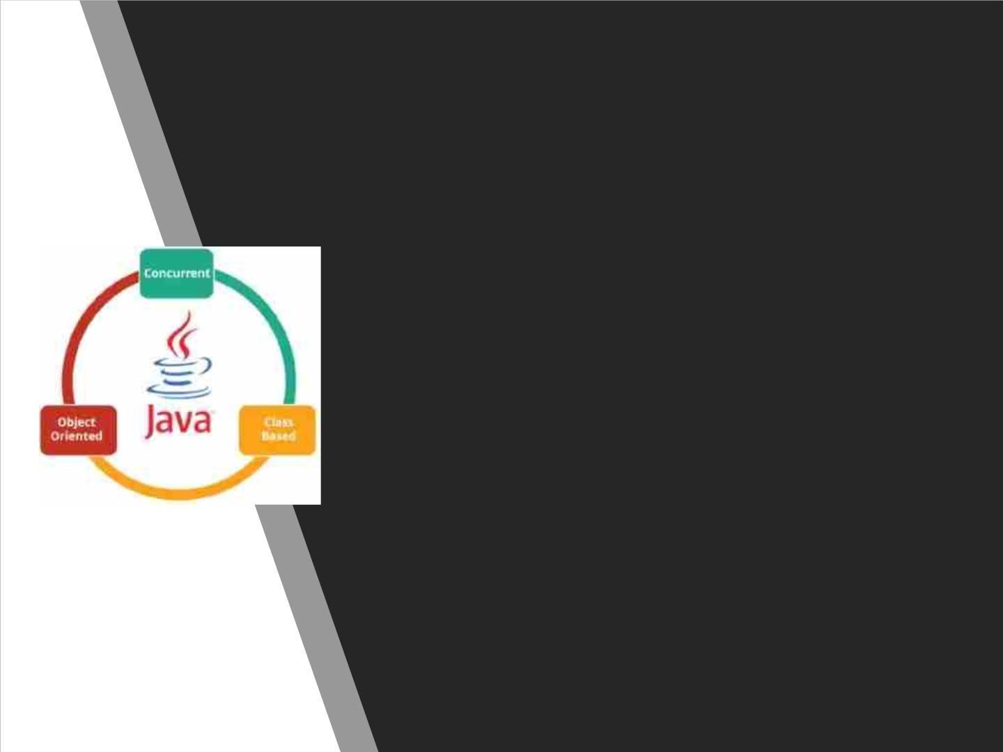
WhatꢀisꢀJava?
• Javaꢀisꢀaꢀcross-platformꢀobject-orientedꢀprogrammingꢀ
languageꢀthatꢀwasꢀreleasedꢀbyꢀSunꢀMicrosystemsꢀinꢀtheꢀ
yearꢀ1995.ꢀ
• Today,ꢀJavaꢀisꢀneededꢀtoꢀrunꢀvariousꢀapplicationsꢀsuchꢀ
asꢀgames,ꢀsocialꢀmediaꢀapplications,ꢀaudioꢀandꢀvideoꢀ
applications,ꢀetc.ꢀ
• Itꢀisꢀanꢀobject-orientedꢀlanguageꢀsimilarꢀtoꢀC++,ꢀbutꢀ
withꢀadvancedꢀandꢀsimplifiedꢀfeatures.ꢀThisꢀlanguageꢀ
isꢀfreeꢀtoꢀaccessꢀandꢀcanꢀrunꢀonꢀallꢀplatforms.

Slide 4

• Banking:ꢀToꢀdealꢀwithꢀtransactionꢀ
management.
• Retail:ꢀBillingꢀapplicationsꢀthatꢀyouꢀseeꢀinꢀaꢀ
store/restaurantꢀareꢀcompletelyꢀwrittenꢀinꢀ
Java.
Whatꢀisꢀ
Javaꢀusedꢀ
for?
• InformationꢀTechnology:ꢀJavaꢀisꢀdesignedꢀ
toꢀsolveꢀimplementationꢀdependencies.
• Android:ꢀApplicationsꢀareꢀeitherꢀwrittenꢀinꢀ
JavaꢀorꢀuseꢀJavaꢀAPI.
• Financialꢀservices:ꢀItꢀisꢀusedꢀinꢀserver-sideꢀ
applications.
• Stockꢀmarket:ꢀToꢀwriteꢀalgorithmsꢀasꢀtoꢀ
whichꢀcompanyꢀtheyꢀshouldꢀinvestꢀin.ꢀꢀ
• BigꢀData:ꢀHadoopꢀMapReduceꢀframeworkꢀ
isꢀwrittenꢀusingꢀJava.
• ScientificꢀandꢀResearchꢀCommunity:ꢀToꢀ
dealꢀwithꢀhugeꢀamountꢀofꢀdata.

Slide 5
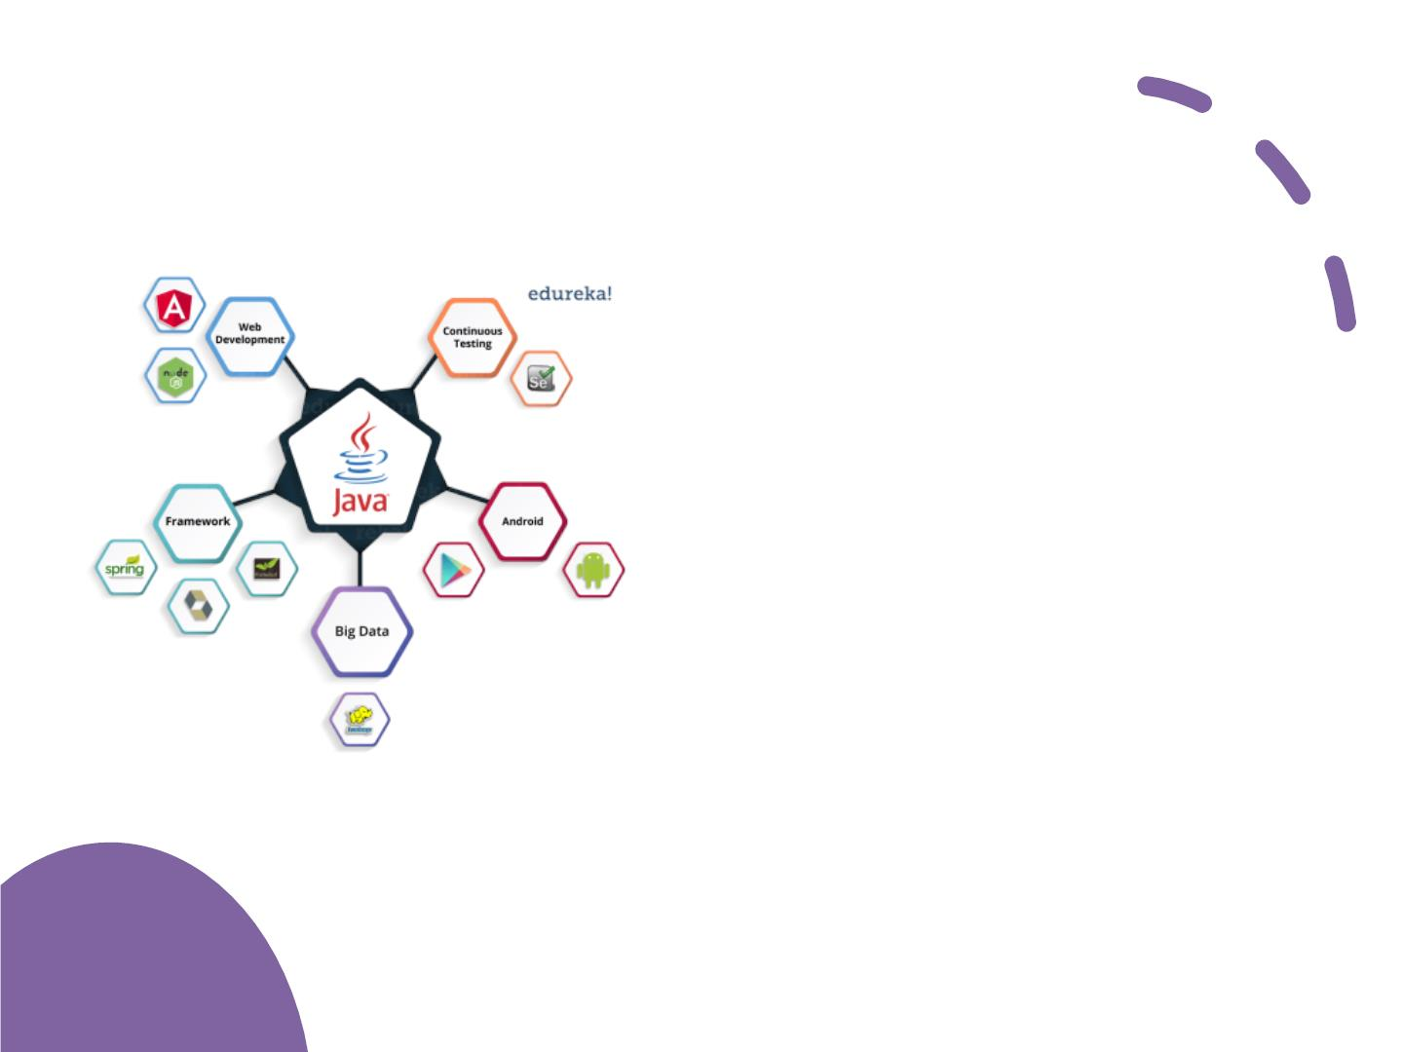
WhatꢀisꢀJavaꢀ
usedꢀfor?
• Concurrentꢀwhereꢀ
youꢀ
canꢀexecuteꢀ manyꢀ statementsꢀ
insteadꢀ ofꢀ sequentiallyꢀexecutingꢀ
it.
• Class-basedꢀandꢀ
anꢀobject-
orientedꢀprogrammingꢀlanguage.
• Independentꢀprogrammingꢀ
languageꢀ thatꢀ followsꢀ theꢀ logicꢀ ofꢀ
“Writeꢀ once,ꢀ Runꢀ anywhere”ꢀ i.e.ꢀ
theꢀ compiledꢀ codeꢀ canꢀ runꢀ onꢀ allꢀ
platformsꢀwhichꢀsupportsꢀjava.
• Inꢀ simpleꢀ words,ꢀ itꢀ isꢀ aꢀ computingꢀ
platformꢀ whereꢀ youꢀ canꢀ developꢀ
applications.

Slide 6
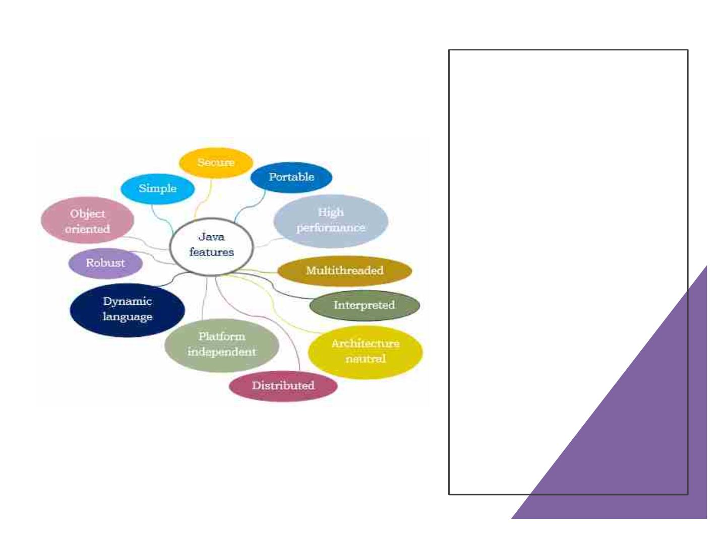
Features

Slide 7
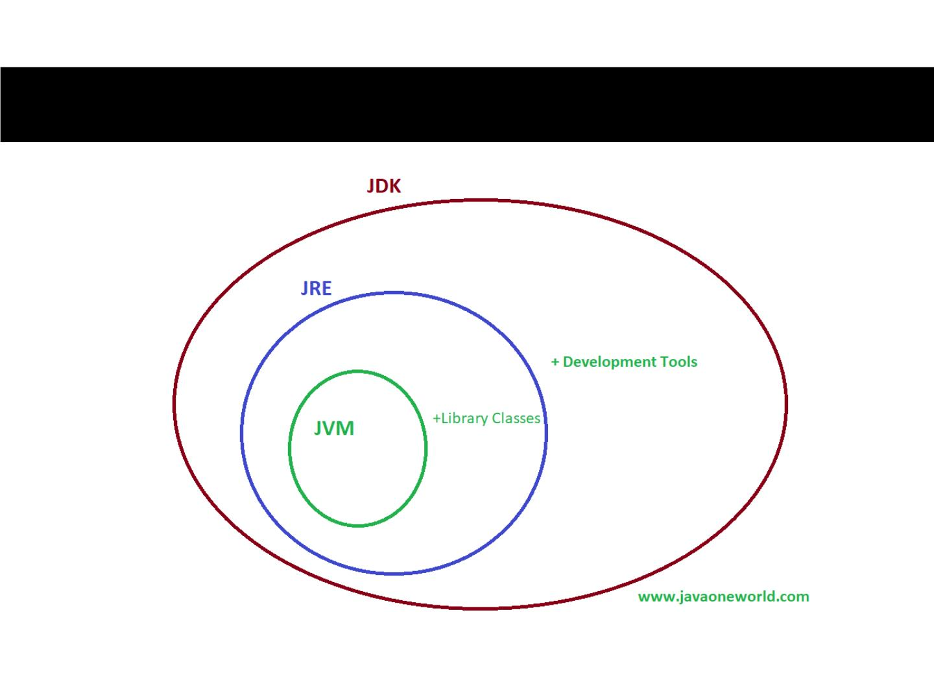
Components

Slide 8

WhyꢀJavaꢀisꢀaꢀPopularꢀ
Programmingꢀ
Language?
Featuresꢀ!!!!!

Slide 9

Theꢀbyte-codeꢀverificationꢀbeforeꢀtheꢀexecutionꢀtakesꢀplace,ꢀ
thereforeꢀtheꢀprogramꢀbecomesꢀunableꢀtoꢀjumpꢀtoꢀaꢀmaliciousꢀorꢀ
undefinedꢀinstructionꢀorꢀtoꢀmakeꢀaꢀtypeꢀerrorꢀatꢀtheꢀinstructionꢀ
level.
Theꢀautomaticꢀboundsꢀcheckingꢀofꢀarraysꢀnullꢀcheckingꢀofꢀ
referencesꢀverificationꢀofꢀcastsꢀpreventsꢀtheꢀprogramꢀfromꢀmakingꢀ
anyꢀtypeꢀerrors.
WhyꢀJavaꢀ
isꢀsecure?
Wheneverꢀaꢀnewꢀcodeꢀisꢀbeingꢀloaded,ꢀrun-timeꢀsecurityꢀchecksꢀ
takeꢀplace.ꢀTheꢀusageꢀofꢀsecurityꢀmanagerꢀandꢀclassꢀloaderꢀmakesꢀ
itꢀeasyꢀforꢀtheꢀJavaꢀrun-timeꢀtoꢀavoidꢀanyꢀarbitraryꢀcodeꢀfromꢀ
executingꢀbyꢀmediatingꢀaccessꢀtoꢀtheꢀsystemꢀresourcesꢀandꢀ
preventingꢀtheꢀprogramꢀfromꢀloadingꢀorꢀgeneratingꢀanyꢀarbitraryꢀ
codeꢀatꢀrun-time.
Javaꢀprovidesꢀlibraryꢀlevelꢀsafety.

Slide 10
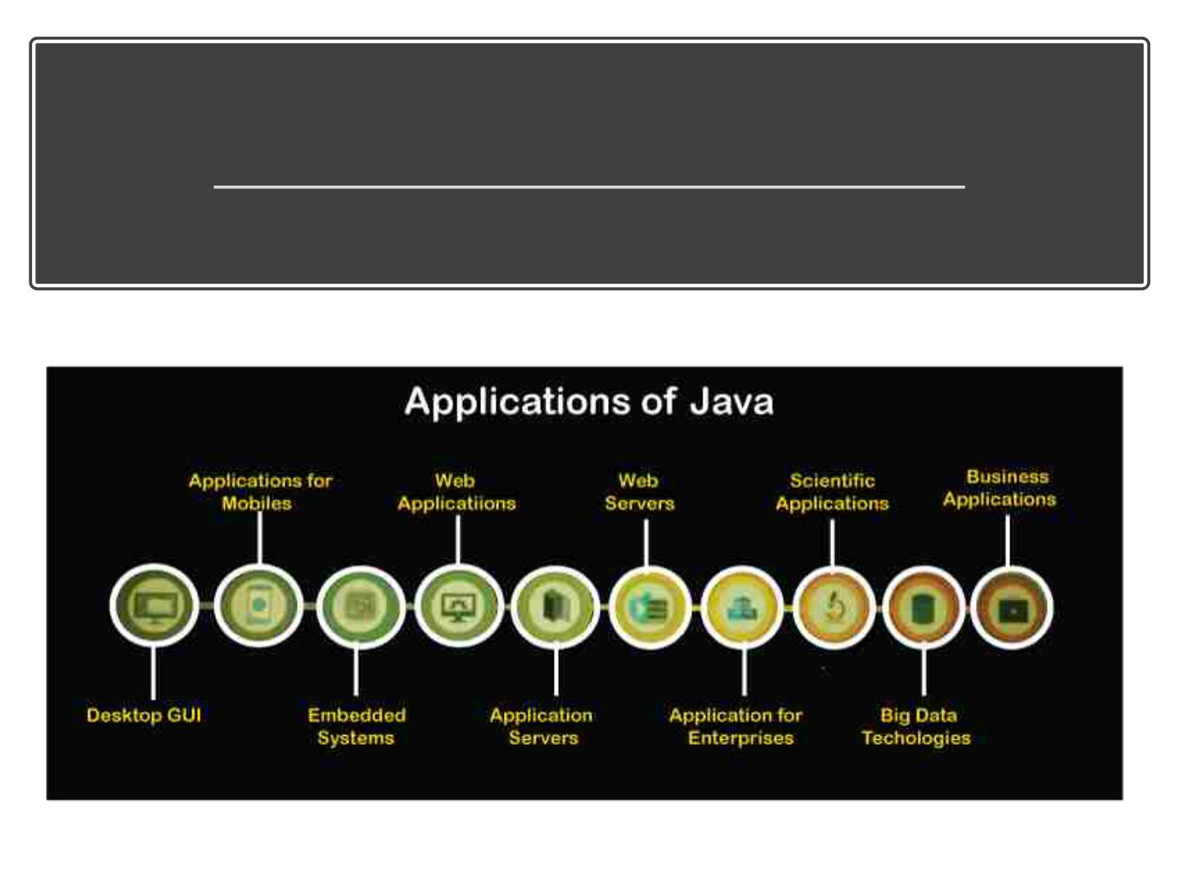
WhatꢀareꢀtheꢀdifferentꢀApplicationsꢀofꢀJava?

Slide 11
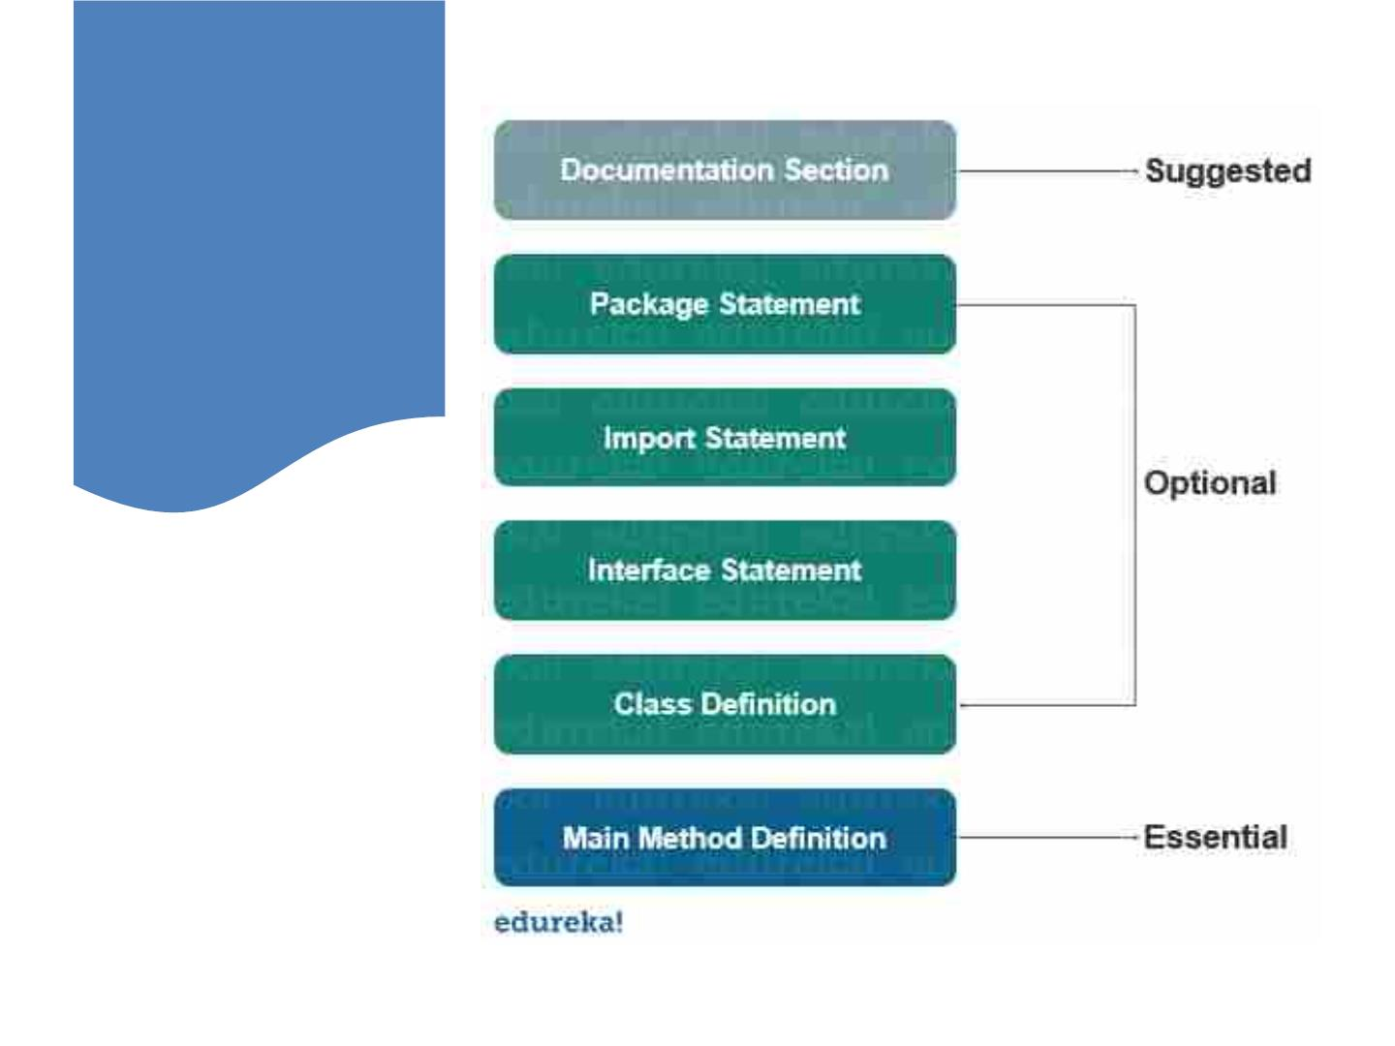
Basicꢀ
Structureꢀofꢀ
aꢀJavaꢀ
Program

Slide 12

Differenceꢀ
betweenꢀC,ꢀ
C++ꢀandꢀ
Java?
Metrics
C
C++
Java
Programmingꢀ
Paradigm
Proceduralꢀ
language
Object-Orientedꢀ
Programmingꢀ
(OOP)
PureꢀObjectꢀ
Orientedꢀ
Oriented
Basedꢀonꢀ
assemblyꢀ
language
BasedꢀonꢀCꢀ
language
BasedꢀonꢀCꢀandꢀ
C++
Origin
DennisꢀRitchieꢀinꢀ
1972
Bjarneꢀ
Stroustrupꢀinꢀ
1979
JamesꢀGoslingꢀinꢀ
1991
Developer
Interpretedꢀ
languageꢀ
(Compilerꢀ+ꢀ
interpreter)
Translator
Compilerꢀonly
Compilerꢀonly
Platformꢀ
Dependency
Platformꢀ
Dependent
Platformꢀ
Dependent
Platformꢀ
Independent
ExecutedꢀbyꢀJVMꢀ
(JavaꢀVirtualꢀ
Machine)
Codeꢀexecution
Direct
Direct

Slide 13

Differenceꢀ
betweenꢀC,ꢀ
C++ꢀandꢀ
Java?
Metrics
C
C++
Java
.classꢀfiles
Fileꢀgeneration
.exeꢀfiles
.exeꢀfiles
Pre-processorꢀ
directives
Supportꢀheaderꢀ
filesꢀ(#include,ꢀ
#define)
Supportedꢀ
(#header,ꢀ#define)
UseꢀPackagesꢀ
(import)
keywords
Supportꢀ32ꢀ
keywords
Supportsꢀ63ꢀ
keywords
50ꢀdefinedꢀ
keywords
Datatypesꢀ
(union,ꢀ
structure)
Supported
Supported
Supported
Notꢀsupported
Supportedꢀexceptꢀ
Multipleꢀ
inheritance
Inheritance
Overloading
Noꢀinheritance
SupportꢀFunctionꢀ
overloadingꢀ
(Polymorphism)
Operatorꢀ
overloadingꢀisꢀnotꢀ
supported
Noꢀoverloading
Supported
Pointers
Supported
Notꢀsupported
Allocation
Useꢀmalloc,ꢀcalloc Useꢀnew,ꢀdelete Garbageꢀcollector

Slide 14

Differenceꢀ
betweenꢀC,ꢀ
C++ꢀandꢀ
Java?
Metrics
C
C++
Java
Exceptionꢀ
Handling
Notꢀsupported
Supported
Supported
Templates
Notꢀsupported
Supported
Supported
Notꢀsupported
Notꢀsupported
Noꢀconstructorꢀ
neitherꢀ
destructor
Destructors
Multithreading/ꢀ
Interfaces
Notꢀsupported
Notꢀsupported
Notꢀsupported
Notꢀsupported
Supported
Supported
Databaseꢀ
connectivity
StorageꢀClasses
Supportedꢀ(ꢀ
auto,ꢀexternꢀ)
Supportedꢀ(ꢀ
auto,ꢀexternꢀ)
Notꢀsupported
Exceptionꢀ
Handling
Notꢀsupported
Notꢀsupported
Supported
Supported
Supported
Templates
Notꢀsupported

Slide 15
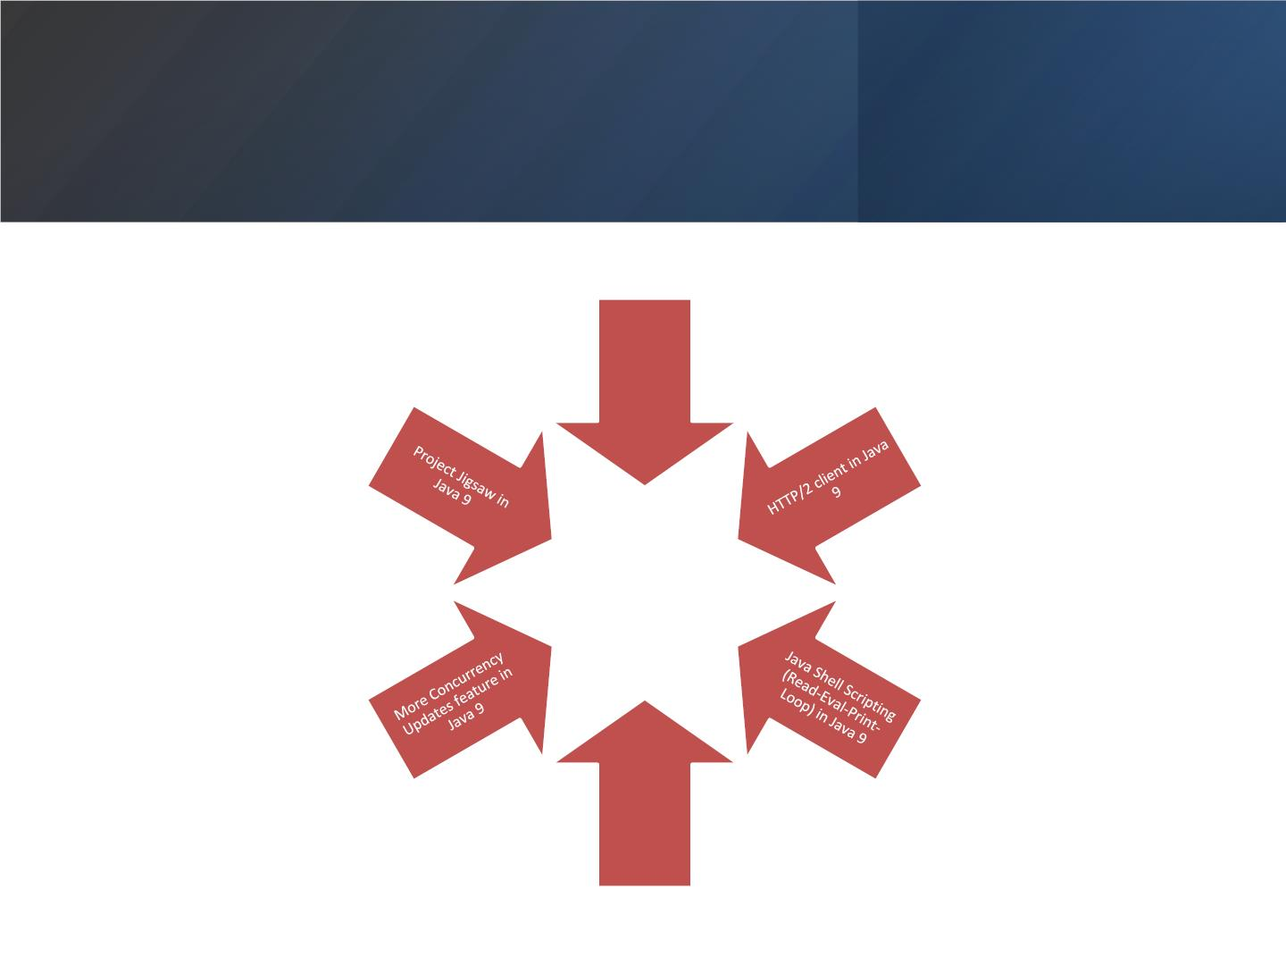
ProcessꢀAPIꢀ
updatesꢀinꢀ
Javaꢀ9
Multi-
releaseꢀJARꢀ
filesꢀ
featureꢀinꢀ
Javaꢀ9

Slide 16

WHATꢀAREꢀJAVAꢀ
FRAMEWORKS?
FRAMEWORKSꢀAREꢀLARGEꢀ
BODIESꢀOFꢀPRE-WRITTENꢀCODEꢀ
TOꢀWHICHꢀYOUꢀADDꢀYOURꢀ
OWNꢀCODEꢀINꢀORDERꢀTOꢀ
SOLVEꢀAꢀPROBLEM.ꢀYOUꢀMAKEꢀ
USEꢀOFꢀAꢀFRAMEWORKꢀBYꢀ
CALLINGꢀITSꢀMETHODS,ꢀ
INHERITANCE,ꢀANDꢀSUPPLYINGꢀ
CALLBACKS,ꢀLISTENERS,ꢀORꢀ
OTHERꢀIMPLEMENTATIONSꢀOFꢀ
THEꢀPATTERNS.
AꢀFRAMEWORKꢀWILLꢀOFTENꢀ
DICTATEꢀTHEꢀSTRUCTUREꢀOFꢀ
ANꢀAPPLICATION.ꢀSOMEꢀ
FRAMEWORKSꢀEVENꢀSUPPLYꢀ
SOꢀMUCHꢀCODEꢀTHATꢀYOUꢀ
HAVEꢀTOꢀDOꢀVERYꢀLITTLEꢀTOꢀ
WRITEꢀYOURꢀAPPLICATION.ꢀ
THISꢀCANꢀBEꢀGOODꢀORꢀBAD,ꢀ
DEPENDINGꢀONꢀHOWꢀEASYꢀITꢀ
ISꢀTOꢀUSE.ꢀFRAMEWORKSꢀAREꢀ
THEꢀSUBSTANCEꢀOFꢀ
YOUꢀBUILDꢀONꢀTOPꢀOFꢀAꢀ
GOODꢀONE,ꢀYOURꢀPROGRAMꢀ
ISꢀSOLIDꢀANDꢀFASTꢀANDꢀ
COMESꢀTOGETHERꢀ
BEAUTIFULLY.ꢀYOUꢀBUILDꢀONꢀ
TOPꢀOFꢀAꢀBADꢀONE,ꢀYOURꢀLIFEꢀ
ISꢀMISERABLE,ꢀBRUTISH,ꢀANDꢀ
SHORT.
PROGRAMMING.ꢀ

Slide 17
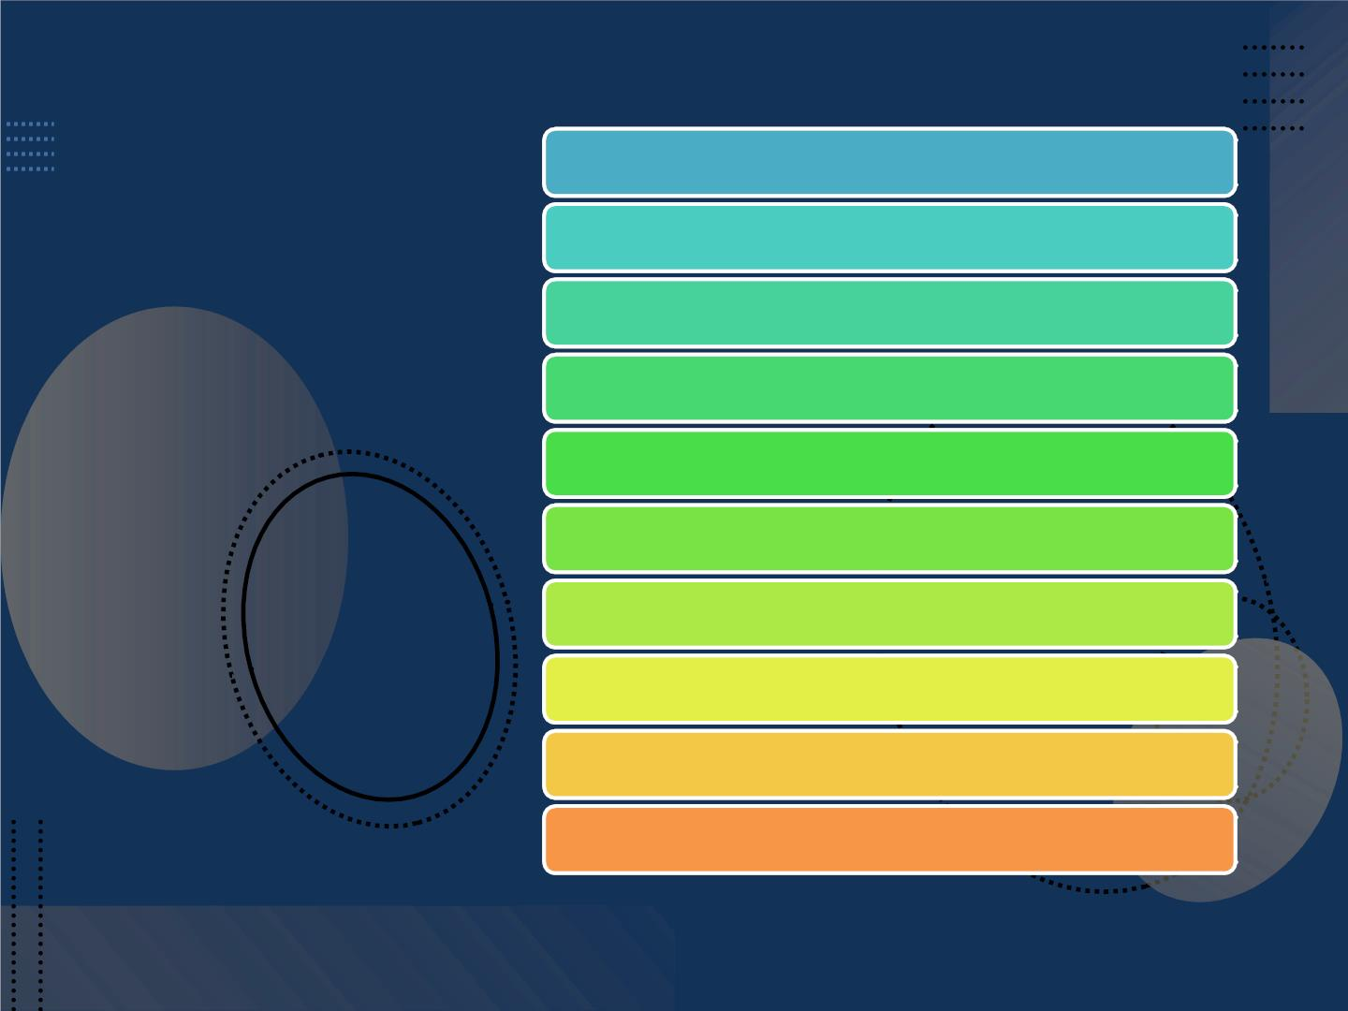
Spring
Hibernate
Topꢀ10ꢀJavaꢀ
Frameworksꢀ
YouꢀShouldꢀ
Know
Struts
Googleꢀwebꢀtoolkitꢀ[GWT]
JavaServerꢀFacesꢀ[JSF]
Grails
Vaadin
Blade
Dropwizard
Play

Slide 18

Downloadꢀ&ꢀInstallꢀJDK
Downloadꢀ&ꢀInstallꢀeitherꢀ
Getꢀstartedꢀ VSꢀCodeꢀorꢀEcllipse
withꢀJava
Git
Setꢀclassꢀpath

Slide 19

Javaꢀ
Environmentꢀ
Setup

Slide 20

HowꢀToꢀSetꢀJavaꢀ
Path?
•
TwoꢀWays
– Temporaryꢀpath
– Permanentꢀpath

Slide 21

WriteꢀHelloꢀWorldꢀ
Program
•
•
HelloꢀWorldꢀProgramꢀinꢀ
Java
SyntaxꢀAnalysis

Slide 22
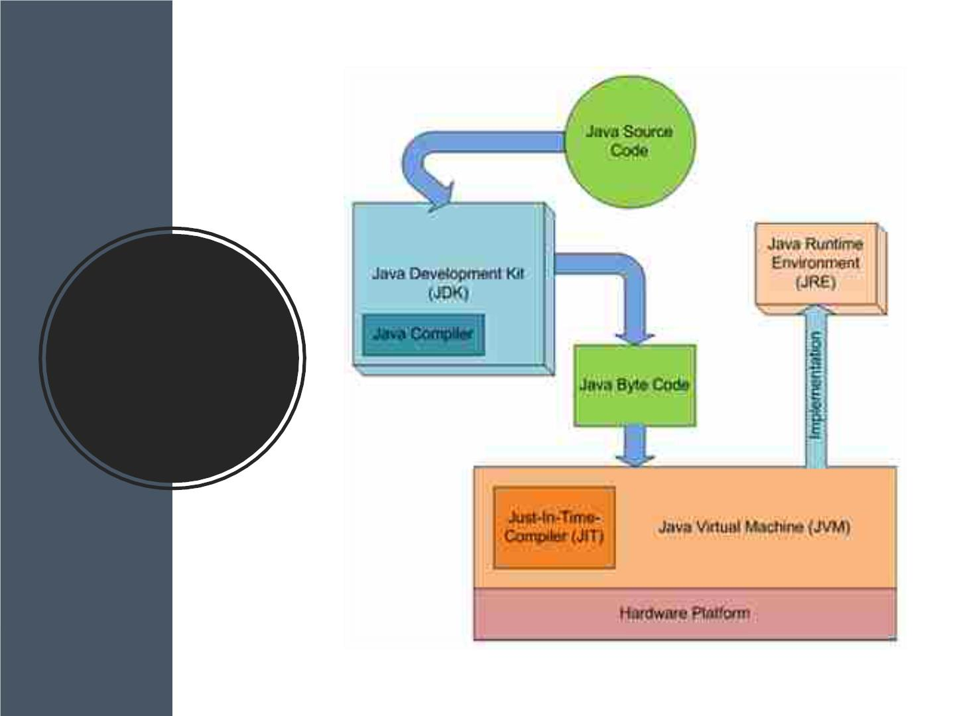
Compileꢀandꢀ
Run

Slide 23

WhatꢀAreꢀCommandꢀ
LineꢀArguments?
Javaꢀprogrammingꢀlanguageꢀisꢀ
versatileꢀinꢀeveryꢀaspect,ꢀbeingꢀ
platform-independentꢀitꢀmakesꢀJavaꢀaꢀ
clearꢀcutꢀwinnerꢀforꢀanyꢀdeveloper.ꢀ
TheꢀexecutionꢀofꢀanyꢀJavaꢀprogramꢀisꢀ
hustle-freeꢀandꢀprecise.ꢀWeꢀcanꢀevenꢀ
passꢀargumentsꢀduringꢀexecutionꢀofꢀaꢀ
programꢀusingꢀtheꢀcommand-lineꢀ
arguments.

Slide 24

JavaꢀCoreꢀ
Concepts

Slide 25
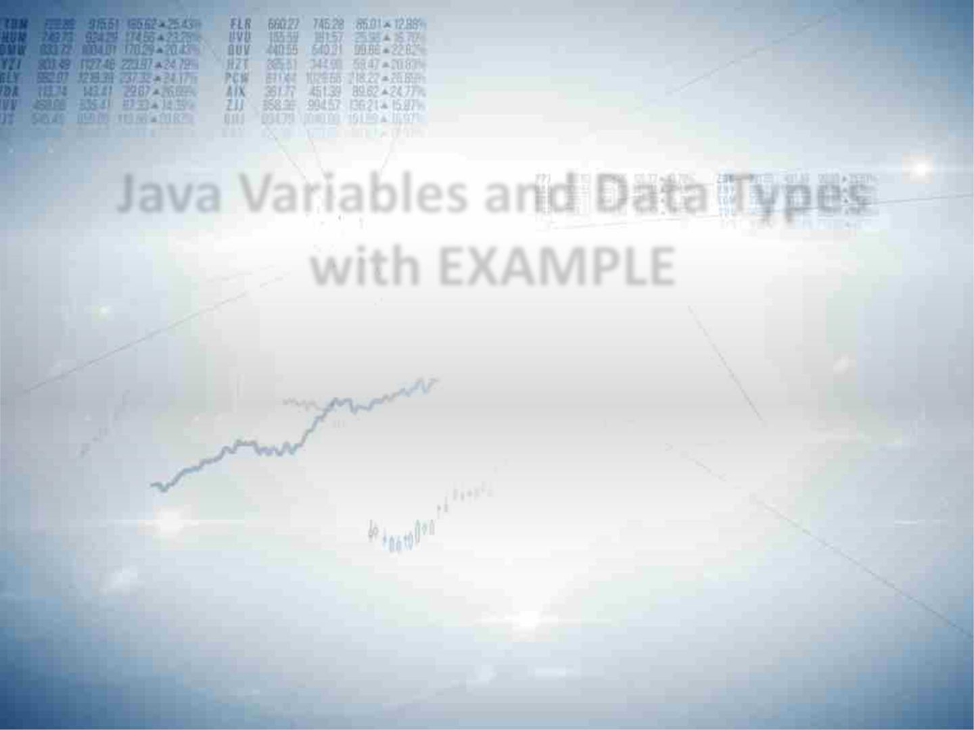
JavaꢀVariablesꢀandꢀDataꢀTypesꢀ
withꢀEXAMPLE

Slide 26

Whatꢀisꢀaꢀ
VariableꢀinꢀJava?
VariableꢀinꢀJavaꢀisꢀaꢀdataꢀ
containerꢀthatꢀstoresꢀtheꢀ
dataꢀvaluesꢀduringꢀJavaꢀ
programꢀexecution.ꢀ
Everyꢀvariableꢀisꢀassignedꢀ
dataꢀtypeꢀwhichꢀ
designatesꢀtheꢀtypeꢀandꢀ
quantityꢀofꢀvalueꢀitꢀcanꢀ
hold.ꢀ
Variableꢀisꢀaꢀmemoryꢀ
locationꢀnameꢀofꢀtheꢀdata.ꢀ
TheꢀJavaꢀvariablesꢀhaveꢀ
mainlyꢀthreeꢀtypesꢀ:ꢀLocal,ꢀ
InstanceꢀandꢀStatic.

Slide 27

Inꢀorderꢀtoꢀuseꢀaꢀvariableꢀ
inꢀaꢀprogramꢀyouꢀtoꢀneedꢀ
toꢀperformꢀ2ꢀsteps
Whatꢀisꢀaꢀ
Variableꢀ
inꢀJava?
VariableꢀDeclaration
VariableꢀInitialization

Slide 28

InꢀJava,ꢀthereꢀareꢀthreeꢀtypesꢀofꢀvariables:
LocalꢀVariables
• LocalꢀVariablesꢀareꢀaꢀvariableꢀthatꢀareꢀdeclaredꢀinsideꢀtheꢀ
bodyꢀofꢀaꢀmethod.
Typesꢀofꢀ
variables
InstanceꢀVariables
• InstanceꢀvariablesꢀareꢀdefinedꢀwithoutꢀtheꢀSTATICꢀ
kvaeryiwabolredsꢀ..TheyꢀareꢀdefinedꢀOutsideꢀaꢀmethodꢀdeclaration.ꢀ
TheyꢀareꢀObjectꢀspecificꢀandꢀareꢀknownꢀasꢀinstanceꢀ
StaticꢀVariables
• Staticꢀvariablesꢀareꢀinitializedꢀonlyꢀonce,ꢀatꢀtheꢀstartꢀofꢀ
theꢀprogramꢀexecution.ꢀTheseꢀvariablesꢀshouldꢀbeꢀ
initializedꢀfirst,ꢀbeforeꢀtheꢀinitializationꢀofꢀanyꢀinstanceꢀ
variables.

Slide 29
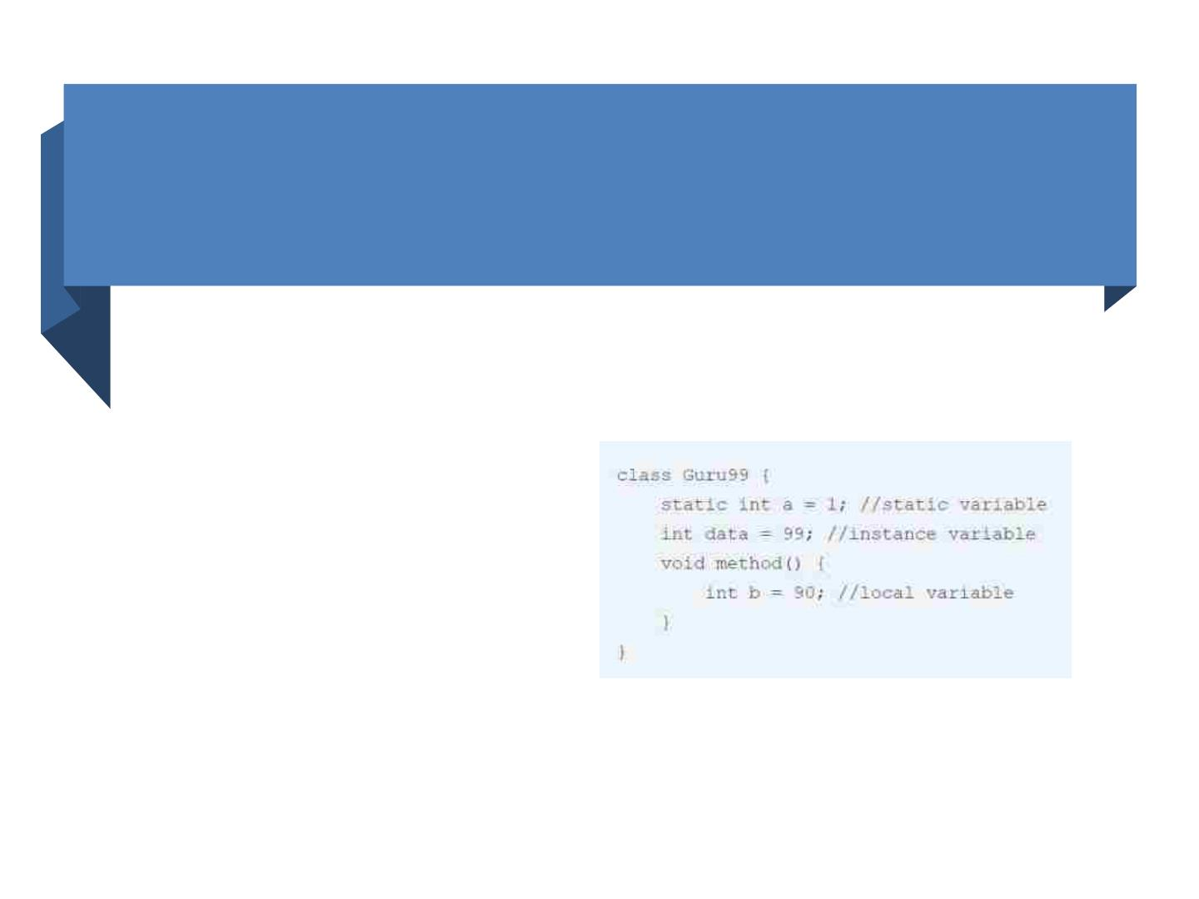
Example:ꢀTypesꢀofꢀVariablesꢀinꢀJava

Slide 30
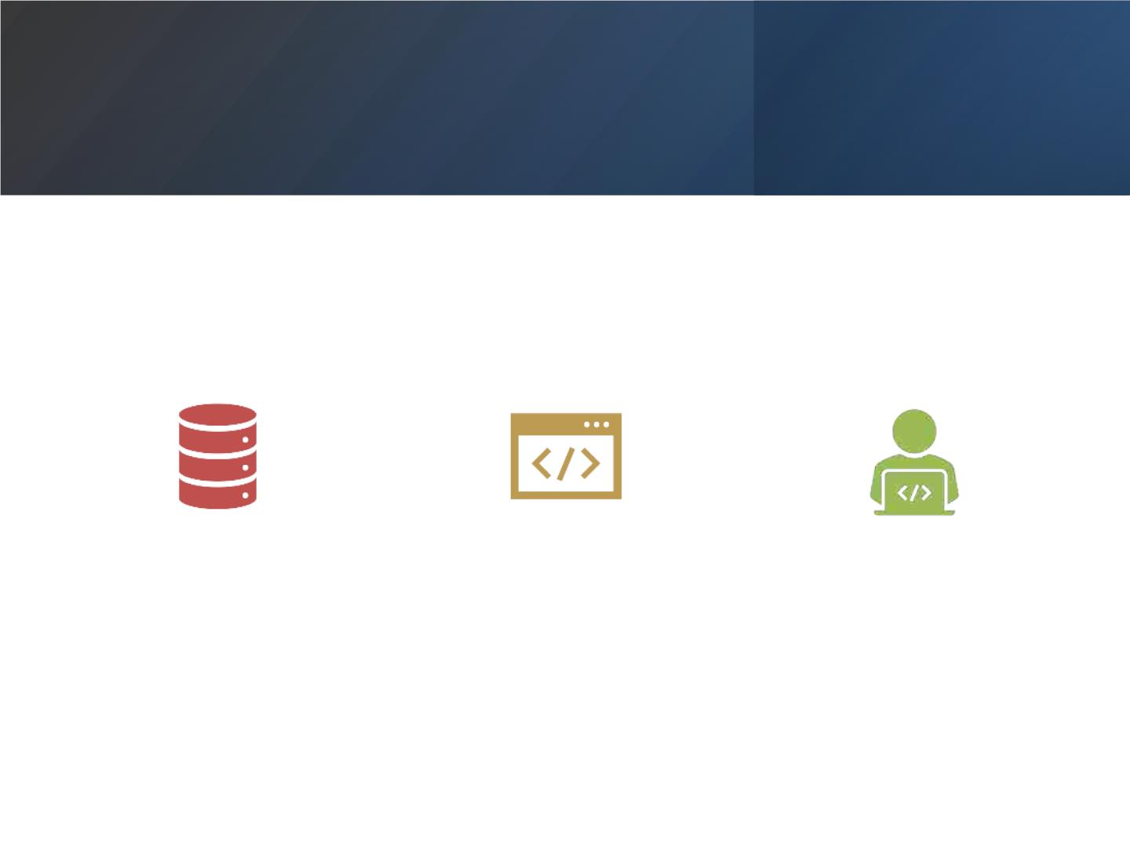
DataꢀTypesꢀinꢀJavaꢀareꢀdefinedꢀasꢀ
specifiersꢀthatꢀallocateꢀdifferentꢀsizesꢀ
andꢀtypesꢀofꢀvaluesꢀthatꢀcanꢀbeꢀstoredꢀ
inꢀtheꢀvariableꢀorꢀanꢀidentifier.ꢀ
Javaꢀhasꢀaꢀrichꢀsetꢀofꢀdataꢀtypes.ꢀ
DataꢀtypesꢀinꢀJavaꢀcanꢀbeꢀdividedꢀintoꢀ
twoꢀparts.

Slide 31
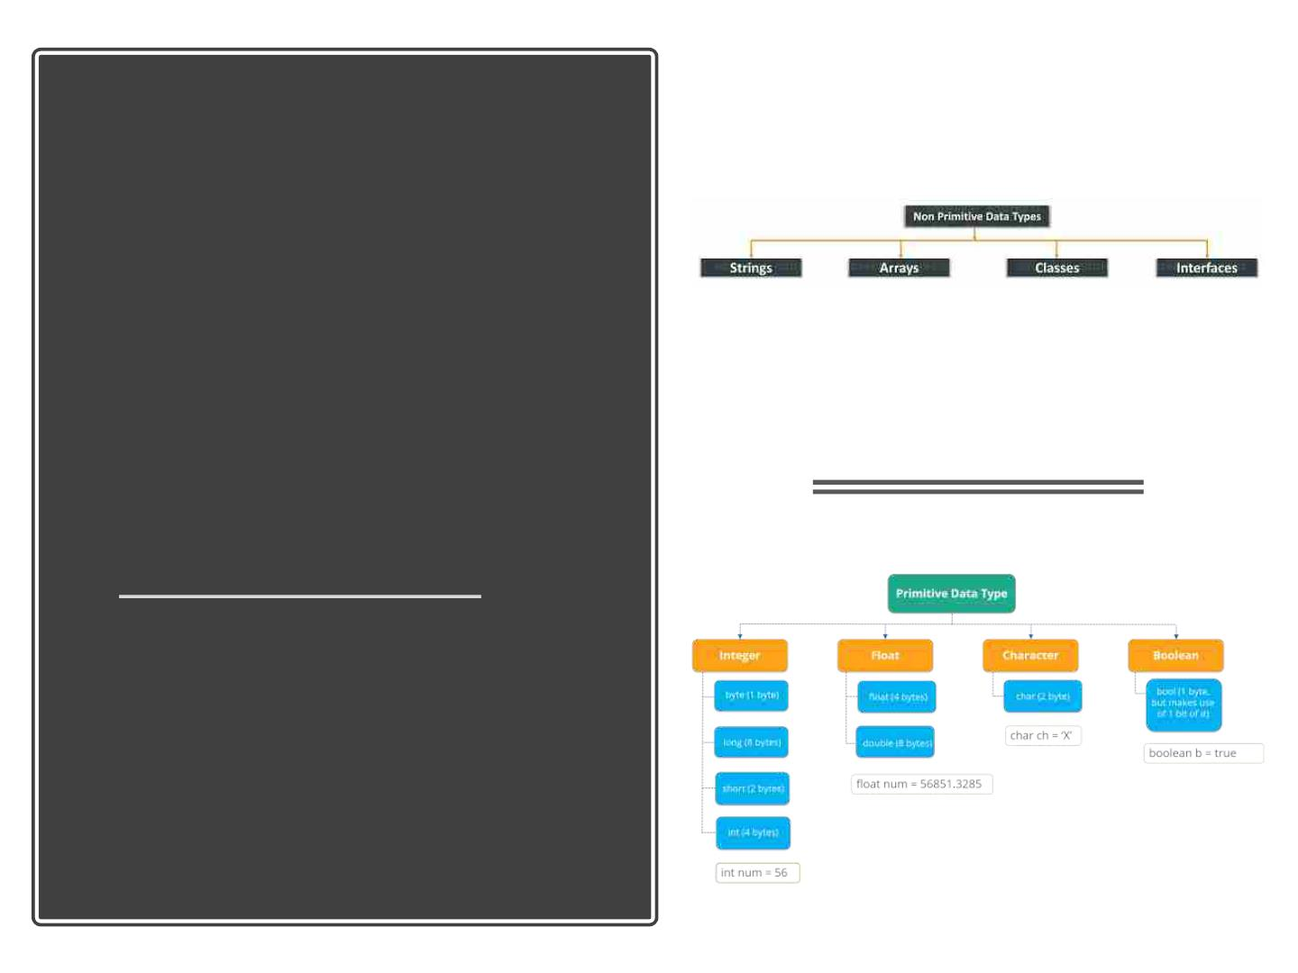
Whatꢀisꢀ
DataꢀTypesꢀ
inꢀJava?

Slide 32

Javaꢀ
• Aꢀvariableꢀofꢀoneꢀtypeꢀcanꢀ
Variableꢀ receiveꢀtheꢀvalueꢀofꢀanotherꢀ
Typeꢀ
Conversionꢀ
&ꢀTypeꢀ
type.ꢀHereꢀthereꢀareꢀ2ꢀcases
– AutomaticꢀConversion
– typeꢀcastꢀoperator
Casting

Slide 33
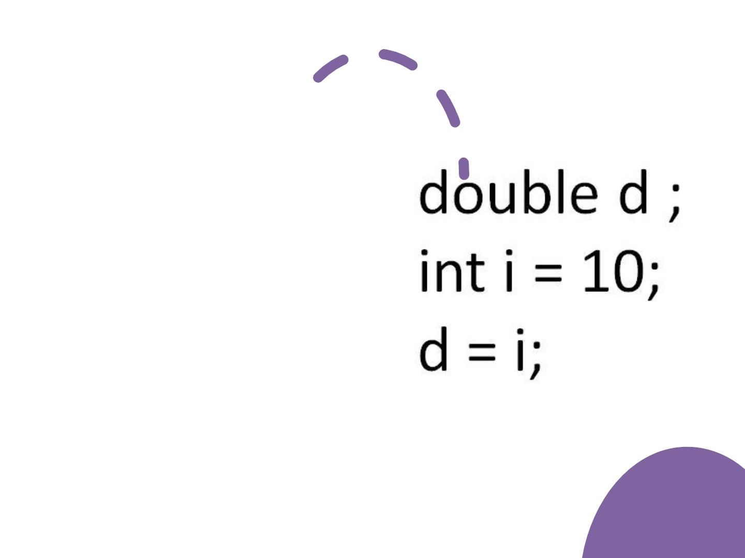
Automaticꢀ
Conversion
• Variableꢀ ofꢀ smallerꢀ
capacityꢀ isꢀ beꢀ assignedꢀ
toꢀ anotherꢀ variableꢀ ofꢀ
biggerꢀcapacity.
• Thisꢀ processꢀ isꢀ
Automatic,ꢀ andꢀ non-
explicitꢀ isꢀ knownꢀ
asꢀConversion

Slide 34
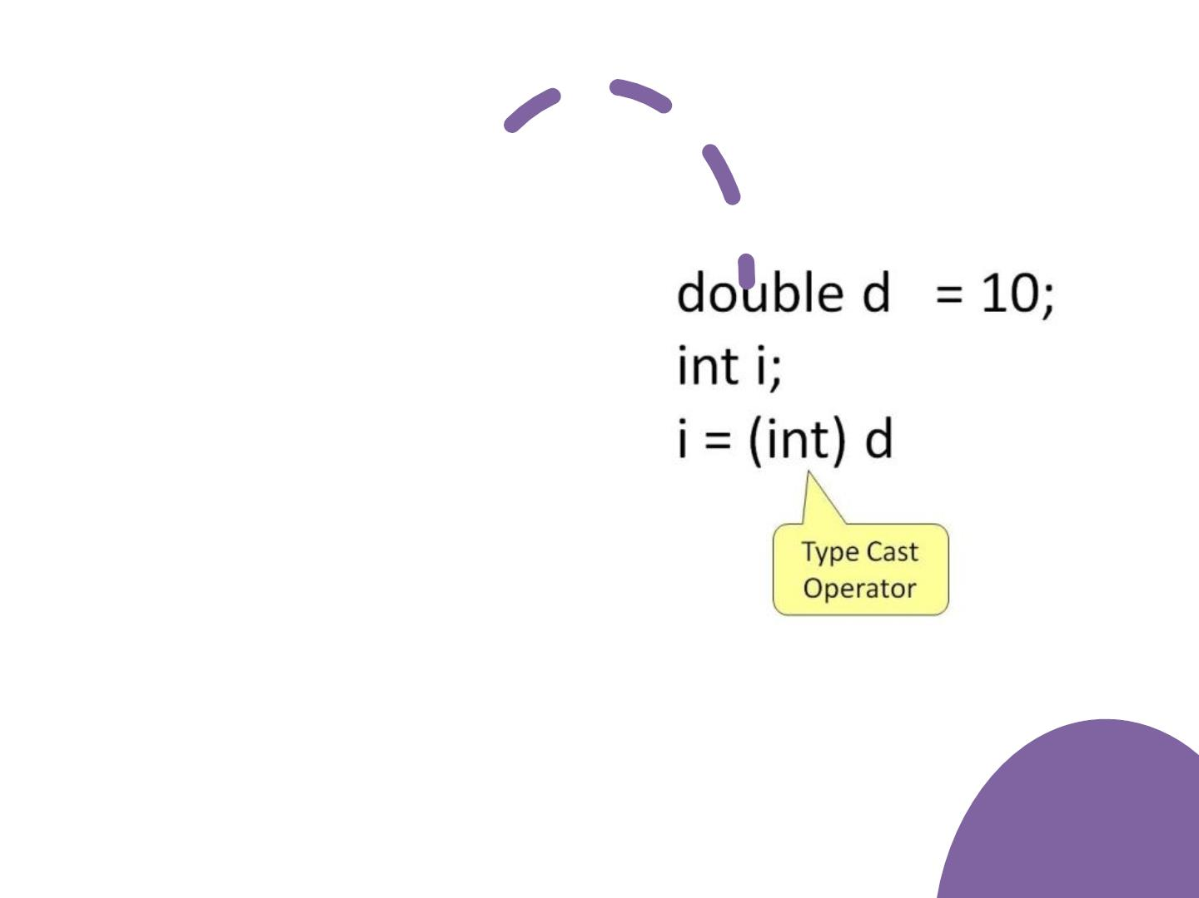
TypeꢀCasting
• Variableꢀ ofꢀ largerꢀ
capacityꢀ isꢀ beꢀ
assignedꢀ toꢀ anotherꢀ
variableꢀ ofꢀ smallerꢀ
capacity.
• Inꢀ suchꢀ cases,ꢀ youꢀ
mustꢀexplicitlyꢀspecifyꢀ
theꢀtypeꢀ
operator.ꢀ
processꢀ isꢀ knownꢀ
asꢀType Casting.
castꢀ
Thisꢀ

Slide 35

Javaꢀ
Operators

Slide 36
• Operatorsꢀareꢀsymbolsꢀthatꢀperformꢀ
operationsꢀonꢀvariablesꢀandꢀvalues.
• OperatorsꢀinꢀJavaꢀcanꢀbeꢀclassifiedꢀ
intoꢀ5ꢀtypes:
– ArithmeticꢀOperators
– AssignmentꢀOperators
– RelationalꢀOperators
– LogicalꢀOperators
– UnaryꢀOperators
Operators(Symbols)
– BitwiseꢀOperators

Slide 37
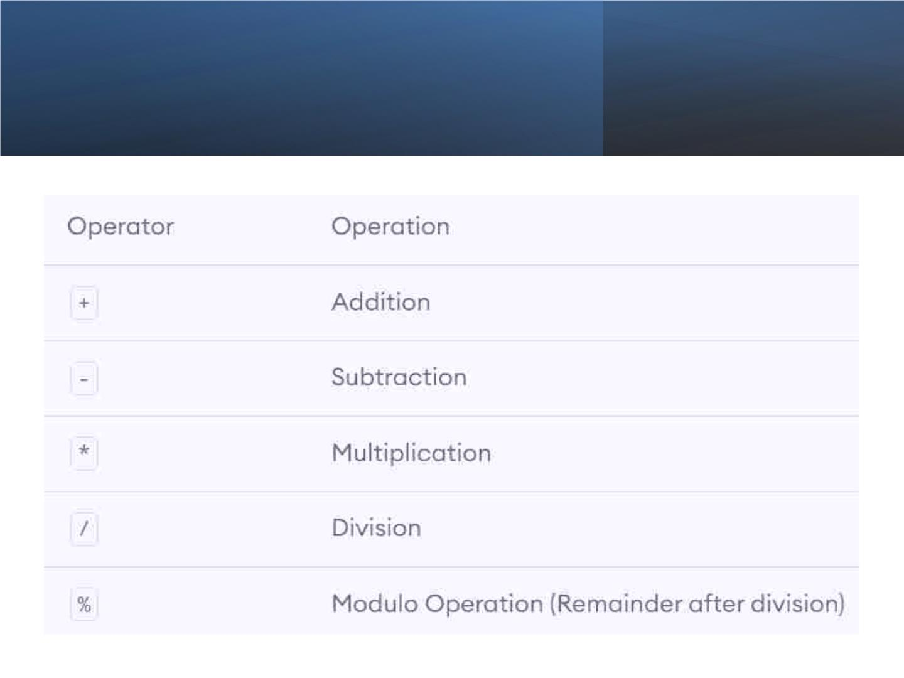

Slide 38
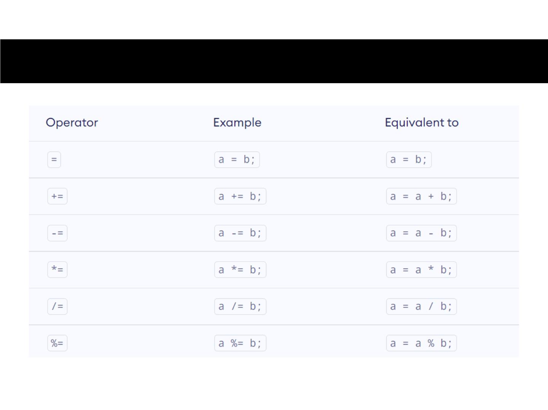
AssignmentꢀOperators

Slide 39
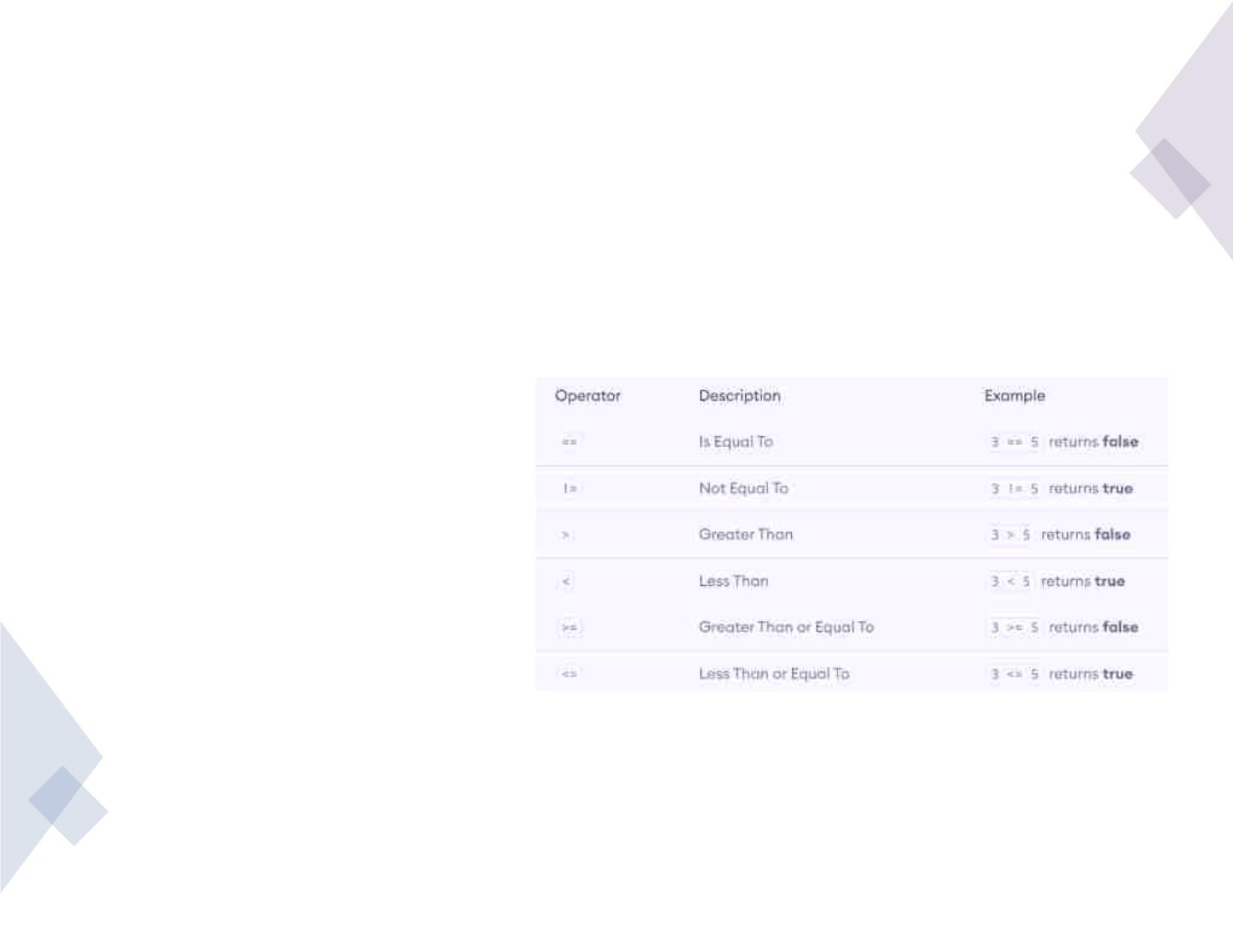
RelationalꢀOperators
• Relationalꢀoperatorsꢀareꢀ
usedꢀtoꢀcheckꢀtheꢀ
relationshipꢀbetweenꢀtwoꢀ
operands.
• Itꢀreturnsꢀ
eitherꢀtrueꢀorꢀfalse.

Slide 40
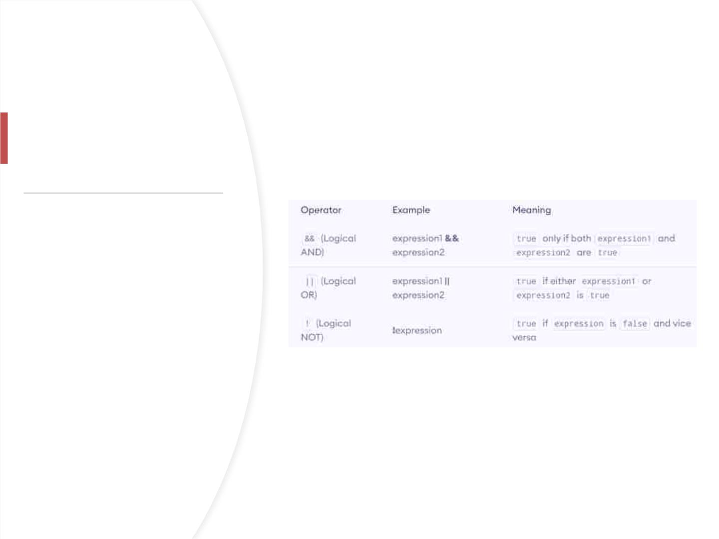
LogicalꢀOperators
• Logicalꢀoperatorsꢀareꢀusedꢀ
toꢀcheckꢀwhetherꢀanꢀ
expressionꢀisꢀtrueꢀorꢀfalse.ꢀ
• Theyꢀareꢀusedꢀinꢀdecisionꢀ
making.

Slide 41
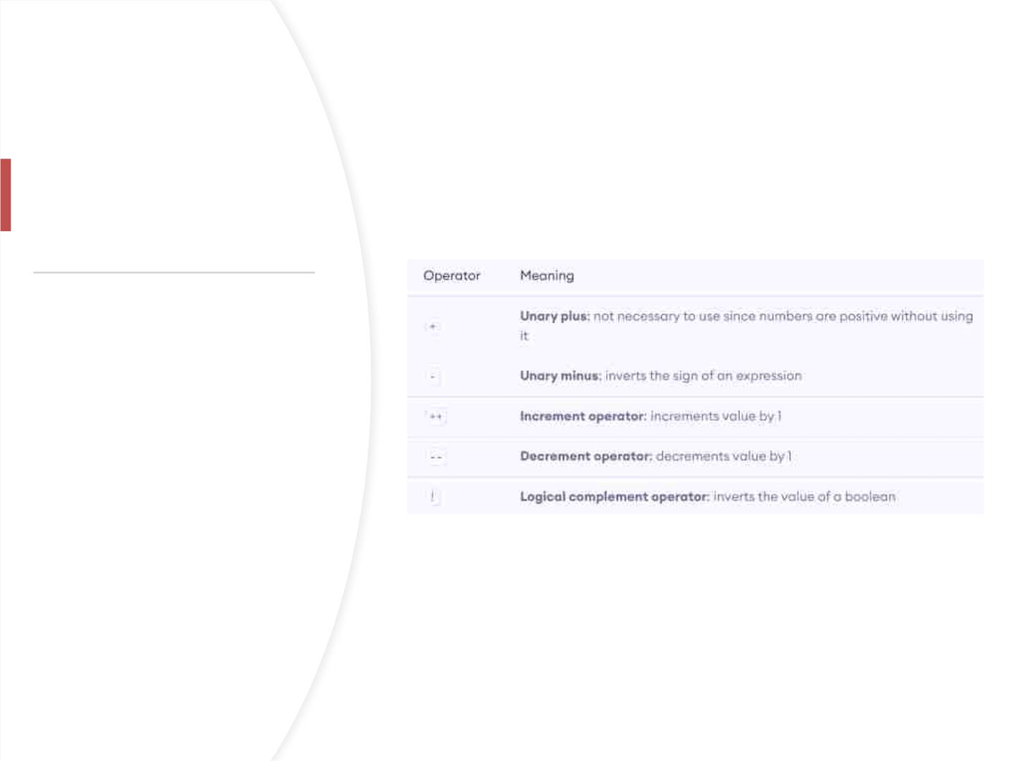
UnaryꢀOperators
• Unaryꢀoperatorsꢀareꢀusedꢀ
withꢀonlyꢀoneꢀoperand.ꢀ
• Forꢀexample,ꢀ++ꢀisꢀaꢀunaryꢀ
operatorꢀthatꢀincreasesꢀ
theꢀvalueꢀofꢀaꢀvariableꢀ
byꢀ1.ꢀ
• Thatꢀis,ꢀ++5ꢀwillꢀreturnꢀ6.

Slide 42

Javaꢀalsoꢀprovidesꢀincrementꢀandꢀ
decrementꢀoperators:ꢀ++ꢀandꢀ--
ꢀrespectively.ꢀ++ꢀincreasesꢀtheꢀ
valueꢀofꢀtheꢀoperandꢀbyꢀ1,ꢀwhileꢀ
--ꢀdecreaseꢀitꢀbyꢀ1.
Incrementꢀ
andꢀ
Decrementꢀ
Operators
Inꢀprogrammingꢀ(Java,ꢀC,ꢀC++,ꢀ
JavaScriptꢀetc.),ꢀtheꢀincrementꢀ
operatorꢀ++ꢀincreasesꢀtheꢀvalueꢀ
ofꢀaꢀvariableꢀbyꢀ1.ꢀSimilarly,ꢀtheꢀ
decrementꢀoperatorꢀ--ꢀdecreasesꢀ
theꢀvalueꢀofꢀaꢀvariableꢀbyꢀ1.

Slide 43

Ifꢀyouꢀuseꢀtheꢀ++ꢀoperatorꢀasꢀaꢀprefixꢀ
like:ꢀ++var,ꢀtheꢀvalueꢀofꢀvarꢀisꢀincrementedꢀ
byꢀ1;ꢀthenꢀitꢀreturnsꢀtheꢀvalue.
++ꢀandꢀ--ꢀ
operatorꢀasꢀ
prefixꢀandꢀ
postfix
Ifꢀyouꢀuseꢀtheꢀ++ꢀoperatorꢀasꢀaꢀpostfixꢀ
like:ꢀvar++,ꢀtheꢀoriginalꢀvalueꢀofꢀvarꢀisꢀ
returnedꢀfirst;ꢀthenꢀvarꢀisꢀincrementedꢀbyꢀ1.
Theꢀ--ꢀoperatorꢀworksꢀinꢀaꢀsimilarꢀwayꢀtoꢀ
theꢀ++ꢀoperatorꢀexceptꢀ--ꢀdecreasesꢀtheꢀ
valueꢀbyꢀ1.

Slide 44
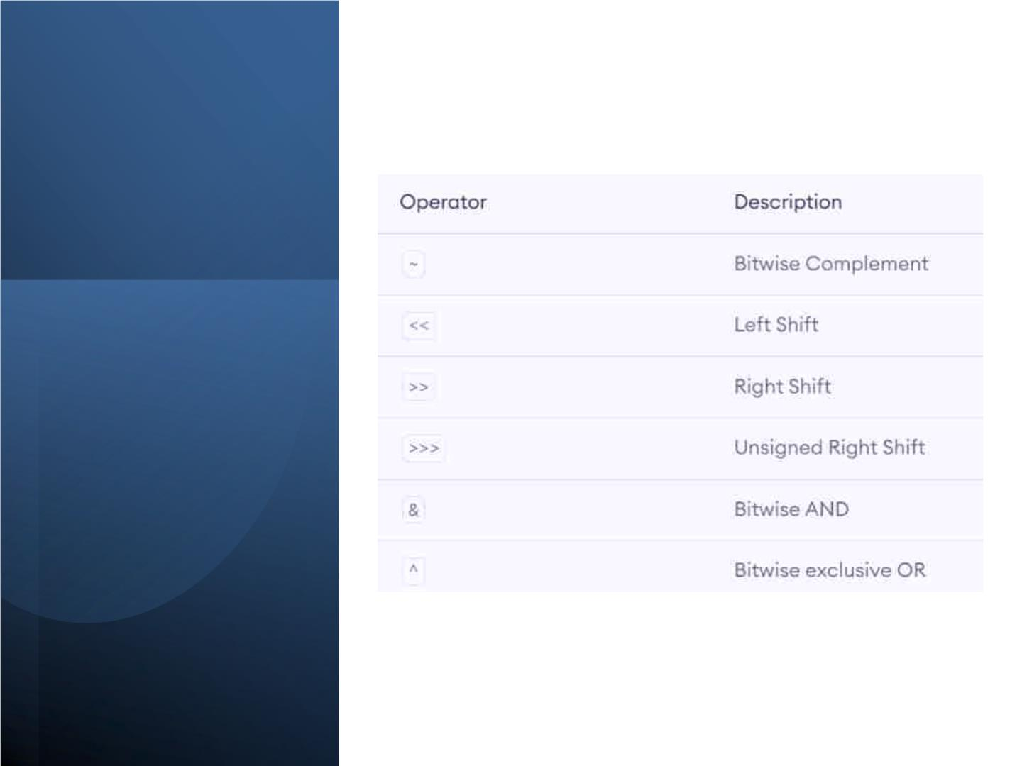

Slide 45

Otherꢀ
operators
• instanceof
– Theꢀinstanceo
• Ternary
– Theꢀternaryꢀ
operatorꢀ
fꢀoperatorꢀ
checksꢀ
(conditionalꢀ
operator)ꢀisꢀ
shorthandꢀforꢀ
theꢀif-then-
elseꢀstatemen
t
whetherꢀanꢀ
objectꢀisꢀanꢀ
instanceofꢀaꢀ
particularꢀ
class.

Slide 46
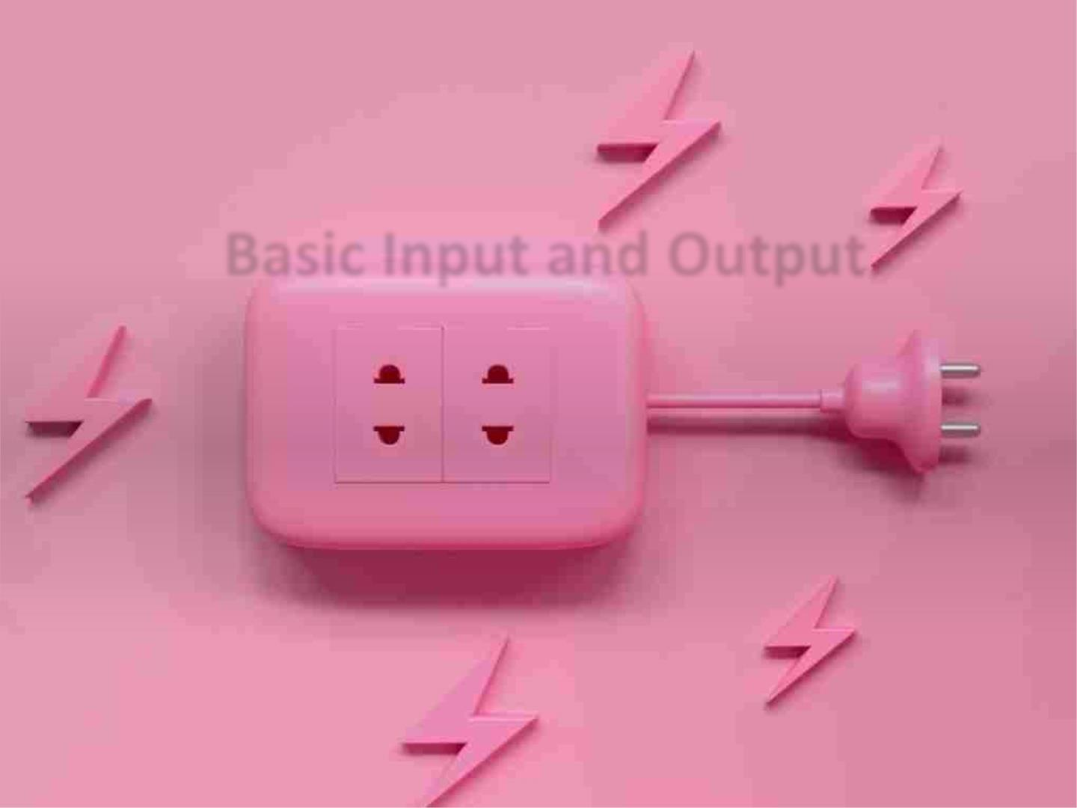
BasicꢀInputꢀandꢀOutput

Slide 47
• InꢀJava,ꢀyouꢀcanꢀsimplyꢀuse
– System.out.println();ꢀ
– System.out.print();ꢀ
Javaꢀ
Output
– System.out.printf();

Slide 48

print()ꢀ-ꢀItꢀprintsꢀstringꢀinsideꢀtheꢀ
quotes.
println()ꢀ-ꢀItꢀprintsꢀstringꢀinsideꢀtheꢀ
quotesꢀsimilarꢀlikeꢀprint()ꢀmethod.ꢀ
Thenꢀtheꢀcursorꢀmovesꢀtoꢀtheꢀ
beginningꢀofꢀtheꢀnextꢀline.
print
printf()ꢀ-ꢀItꢀprovidesꢀstringꢀ
formattingꢀ(similarꢀtoꢀprintfꢀinꢀ
C/C++ꢀprogramming).

Slide 49

JavaꢀInput
Javaꢀprovidesꢀdifferentꢀwaysꢀtoꢀgetꢀ
inputꢀfromꢀtheꢀuser.
Inꢀorderꢀtoꢀuseꢀtheꢀobjectꢀ
ofꢀScanner,ꢀweꢀneedꢀtoꢀ
importꢀjava.util.Scannerꢀpackage.
importꢀjava.util.Scanner;
Then,ꢀweꢀneedꢀtoꢀcreateꢀanꢀobjectꢀ
ofꢀtheꢀScannerꢀclass.ꢀ
Weꢀcanꢀuseꢀtheꢀobjectꢀtoꢀtakeꢀ
inputꢀfromꢀtheꢀuser.

Slide 50

weꢀhaveꢀcreatedꢀanꢀobjectꢀnamedꢀinputꢀofꢀ
theꢀScannerꢀclass.ꢀWeꢀthenꢀcallꢀ
theꢀnextInt()ꢀmethodꢀofꢀtheꢀScannerꢀclassꢀ
toꢀgetꢀanꢀintegerꢀinputꢀfromꢀtheꢀuser.
Similarly,ꢀweꢀcanꢀ
useꢀnextLong(),ꢀnextFloat(),ꢀnextDouble(),ꢀ
andꢀnext()ꢀmethodsꢀtoꢀ
getꢀlong,ꢀfloat,ꢀdouble,ꢀandꢀstringꢀinputꢀ
respectivelyꢀfromꢀtheꢀuser.
Importꢀ
java.util.scanner;
Note:ꢀWeꢀhaveꢀusedꢀtheꢀclose()ꢀmethodꢀtoꢀ
closeꢀtheꢀobject.ꢀItꢀisꢀrecommendedꢀtoꢀ
closeꢀtheꢀscannerꢀobjectꢀonceꢀtheꢀinputꢀisꢀ
taken.

Slide 51

JavaꢀExpressions
• AꢀJavaꢀexpressionꢀconsistsꢀofꢀvariables,ꢀoperators,ꢀ
literals,ꢀandꢀmethodꢀcalls.ꢀToꢀknowꢀmoreꢀaboutꢀmethodꢀ
calls,ꢀvisitꢀJavaꢀmethods.
JavaꢀStatements
Expressions,ꢀ
Statementsꢀ
andꢀBlocks
• InꢀJava,ꢀeachꢀstatementꢀisꢀaꢀcompleteꢀunitꢀofꢀexecution.
Expressionꢀstatements
• Weꢀcanꢀconvertꢀanꢀexpressionꢀintoꢀaꢀstatementꢀbyꢀ
terminatingꢀtheꢀexpressionꢀwithꢀaꢀ;.ꢀTheseꢀareꢀknownꢀasꢀ
expressionꢀstatements.
DeclarationꢀStatements
• InꢀJava,ꢀdeclarationꢀstatementsꢀareꢀusedꢀforꢀdeclaringꢀ
variables.
JavaꢀBlocks
• Aꢀblockꢀisꢀaꢀgroupꢀofꢀstatementsꢀ(zeroꢀorꢀmore)ꢀthatꢀisꢀ
enclosedꢀinꢀcurlyꢀbracesꢀ{ꢀ}

Slide 52
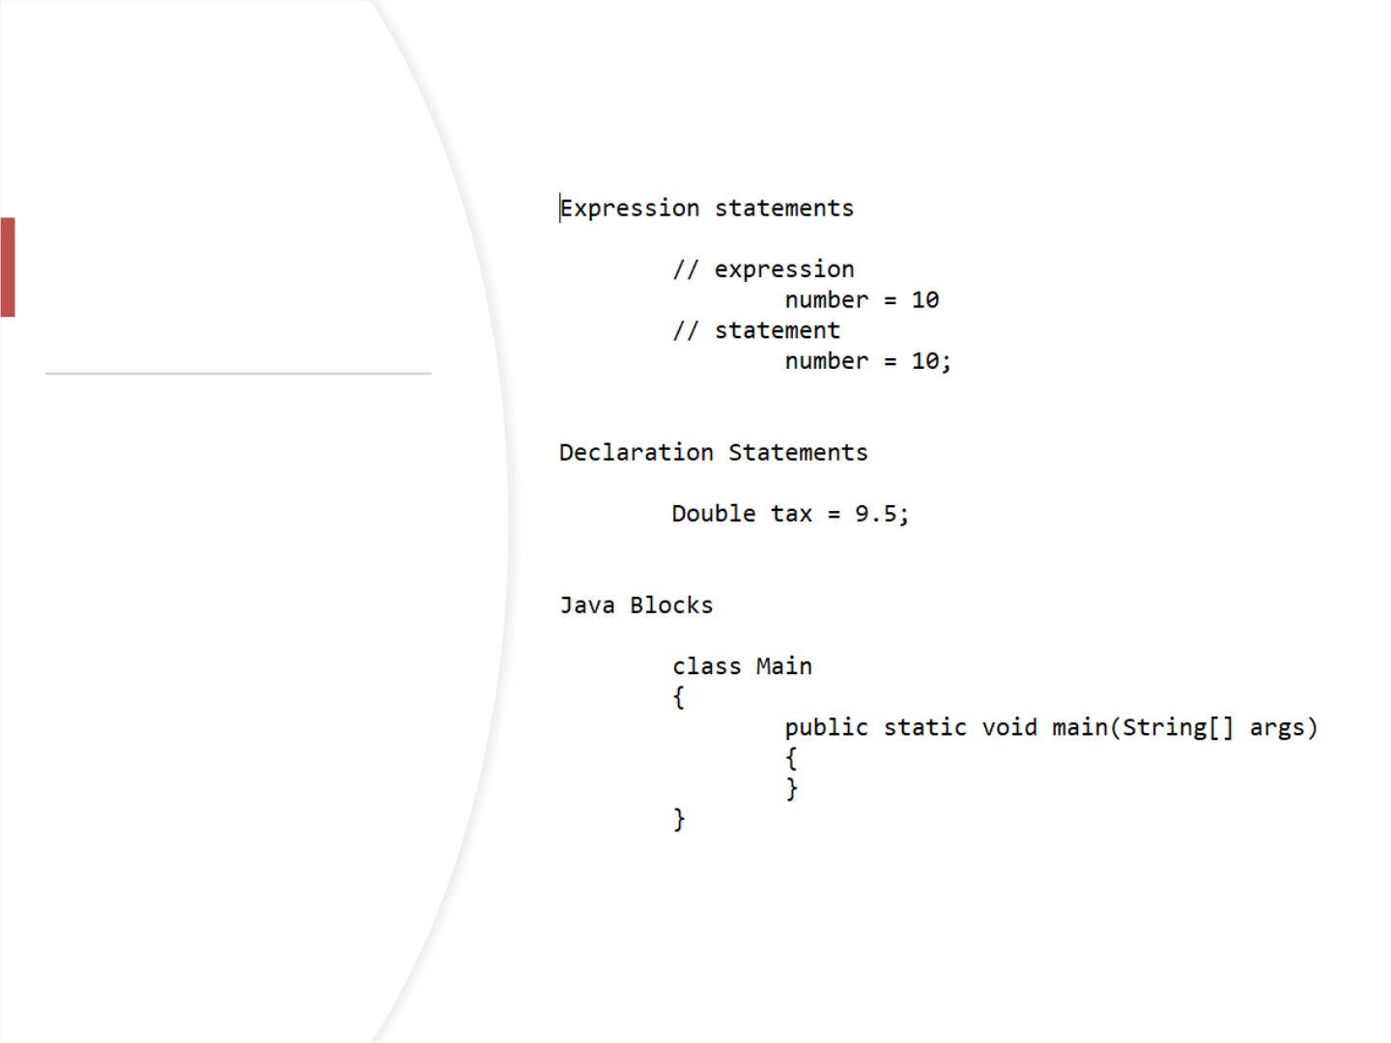
Expressions,ꢀ
Statementsꢀandꢀ
Blocks

Slide 53

JavaꢀComments
•
•
TypesꢀofꢀCommentsꢀinꢀ
Java
InꢀJava,ꢀthereꢀareꢀtwoꢀ
typesꢀofꢀcomments:
– single-lineꢀcommentꢀ
->ꢀ//
– multi-lineꢀcommentꢀ-
>ꢀ/*ꢀ*/
– Doc-lineꢀcommentꢀ->ꢀ
/**ꢀ*/

Slide 54

FlowꢀControl

Slide 55
• Inꢀprogramming,ꢀweꢀuseꢀ
theꢀif..elseꢀstatementꢀtoꢀrunꢀaꢀblockꢀofꢀ
codeꢀamongꢀmoreꢀthanꢀoneꢀ
alternatives.
• WeꢀcanꢀalsoꢀuseꢀJavaꢀStringsꢀasꢀtheꢀtestꢀ
condition.
if...elseꢀ
Statement
• Forꢀexample,ꢀassigningꢀgradesꢀ(A,ꢀB,ꢀC)ꢀ
basedꢀonꢀtheꢀpercentageꢀobtainedꢀbyꢀaꢀ
student.
– ifꢀtheꢀpercentageꢀisꢀaboveꢀ90,ꢀ
assignꢀgradeꢀA
– ifꢀtheꢀpercentageꢀisꢀaboveꢀ75,ꢀ
assignꢀgradeꢀB
– ifꢀtheꢀpercentageꢀisꢀaboveꢀ65,ꢀ
assignꢀgradeꢀC

Slide 56
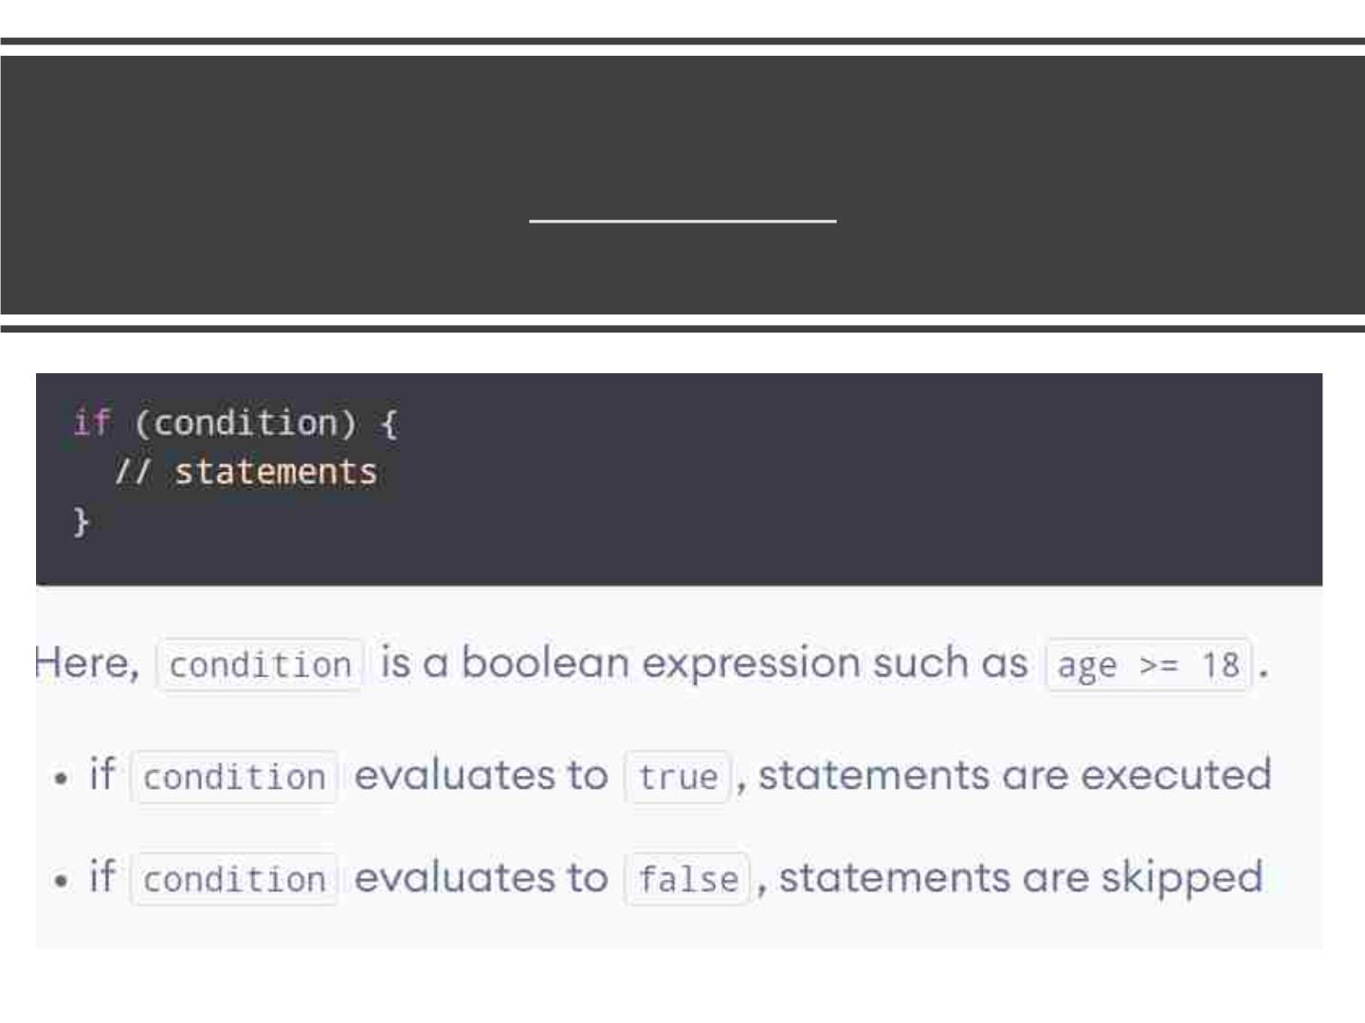
Javaꢀifꢀ(if-then)ꢀStatement

Slide 57
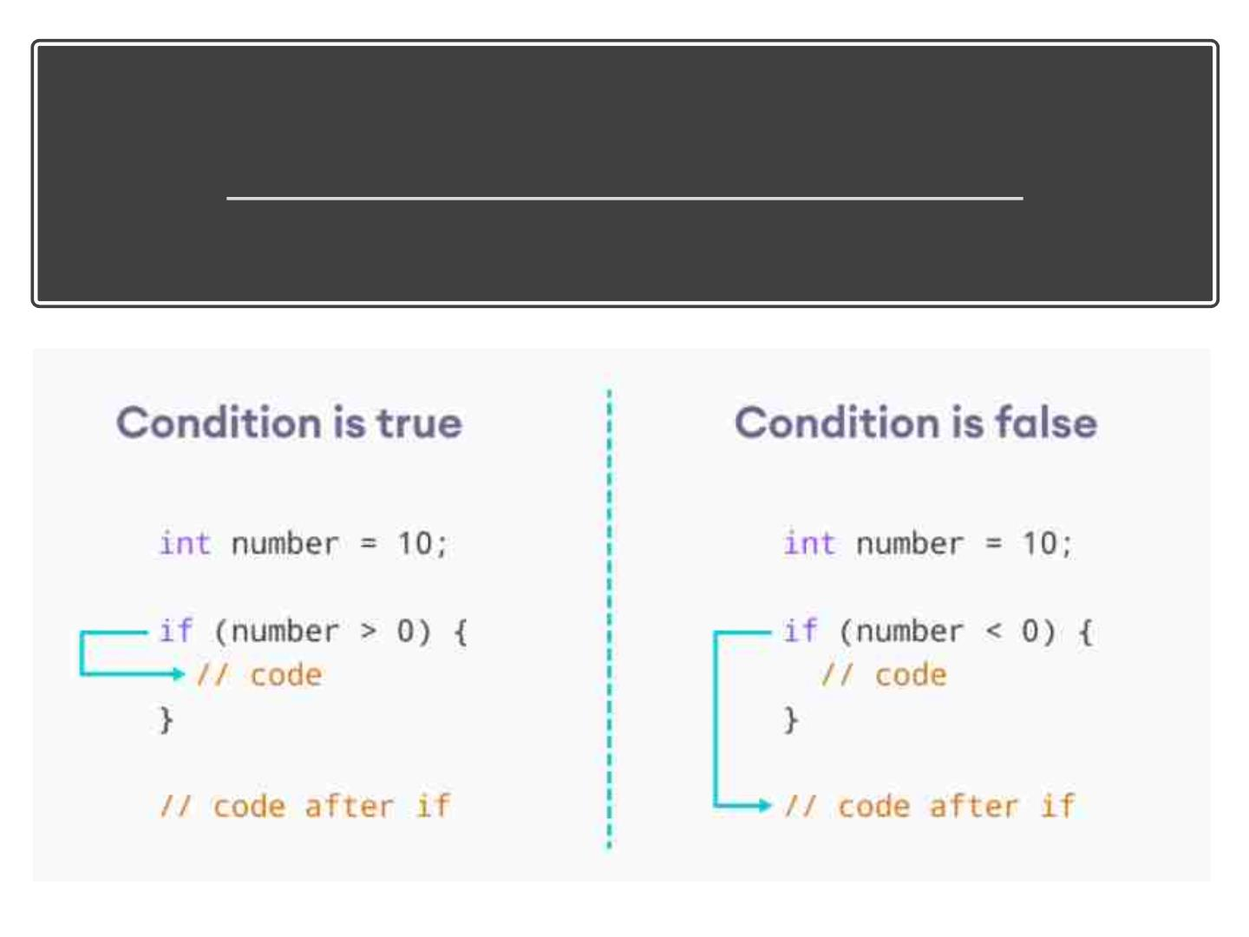
WorkingꢀofꢀifꢀStatement

Slide 58
Javaꢀifꢀ
withꢀ
String
• WeꢀcanꢀalsoꢀuseꢀJavaꢀ
Stringsꢀasꢀtheꢀtestꢀcondition.

Slide 59
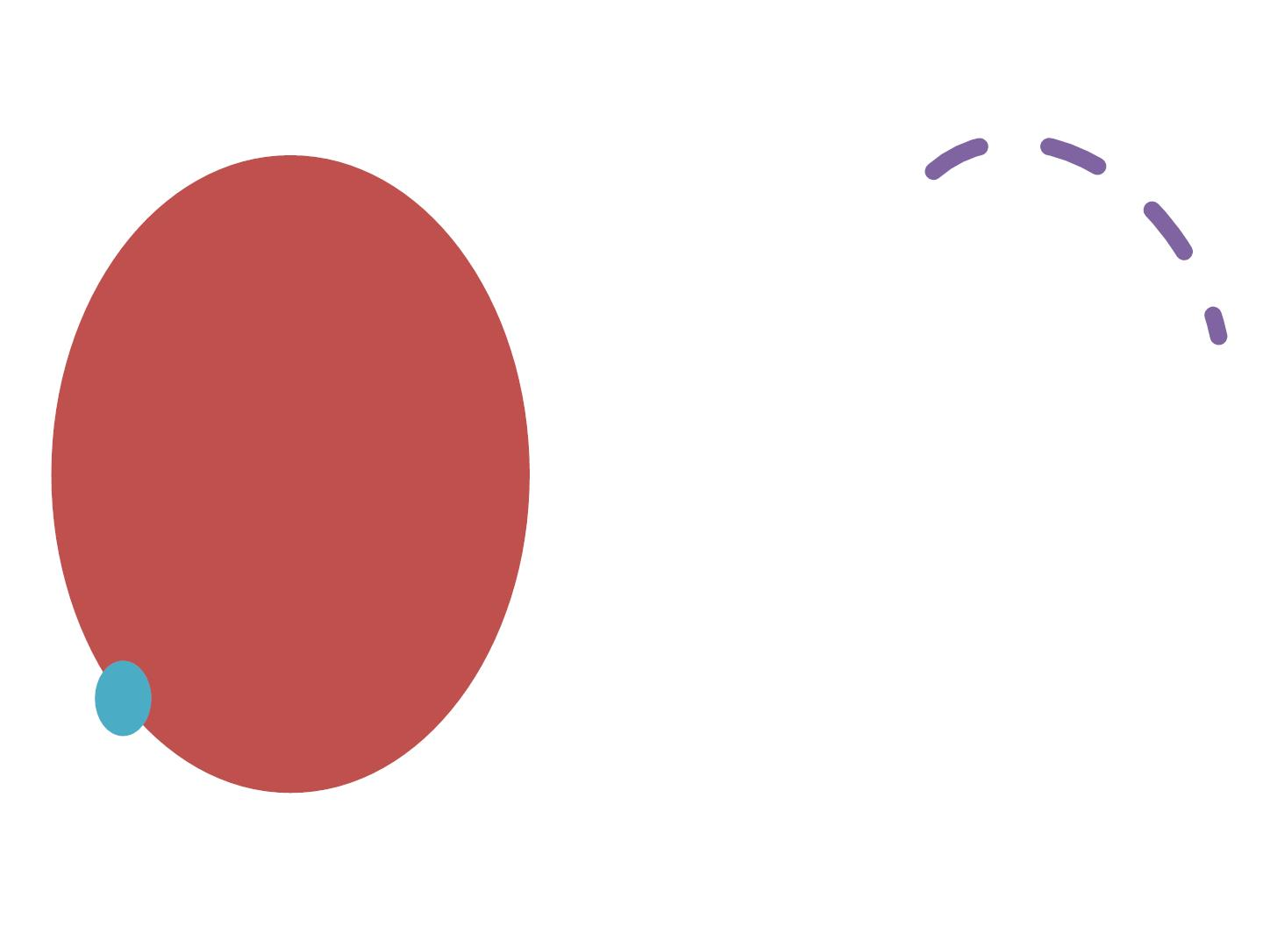
• Theꢀifꢀstatementꢀexecutesꢀaꢀcertainꢀ
sectionꢀofꢀcodeꢀifꢀtheꢀtestꢀ
expressionꢀisꢀevaluatedꢀtoꢀtrue.ꢀ
Javaꢀ
• However,ꢀifꢀtheꢀtestꢀexpressionꢀisꢀ
evaluatedꢀtoꢀfalse,ꢀitꢀdoesꢀnothing.
• Inꢀthisꢀcase,ꢀweꢀcanꢀuseꢀanꢀ
optionalꢀelseꢀblock.ꢀStatementsꢀ
insideꢀtheꢀbodyꢀofꢀelseꢀblockꢀareꢀ
executedꢀifꢀtheꢀtestꢀexpressionꢀisꢀ
evaluatedꢀtoꢀfalse.ꢀ
if...elseꢀ(if-
then-else)ꢀ
Statement
• Thisꢀisꢀknownꢀasꢀtheꢀif-
...elseꢀstatementꢀinꢀJava.

Slide 60
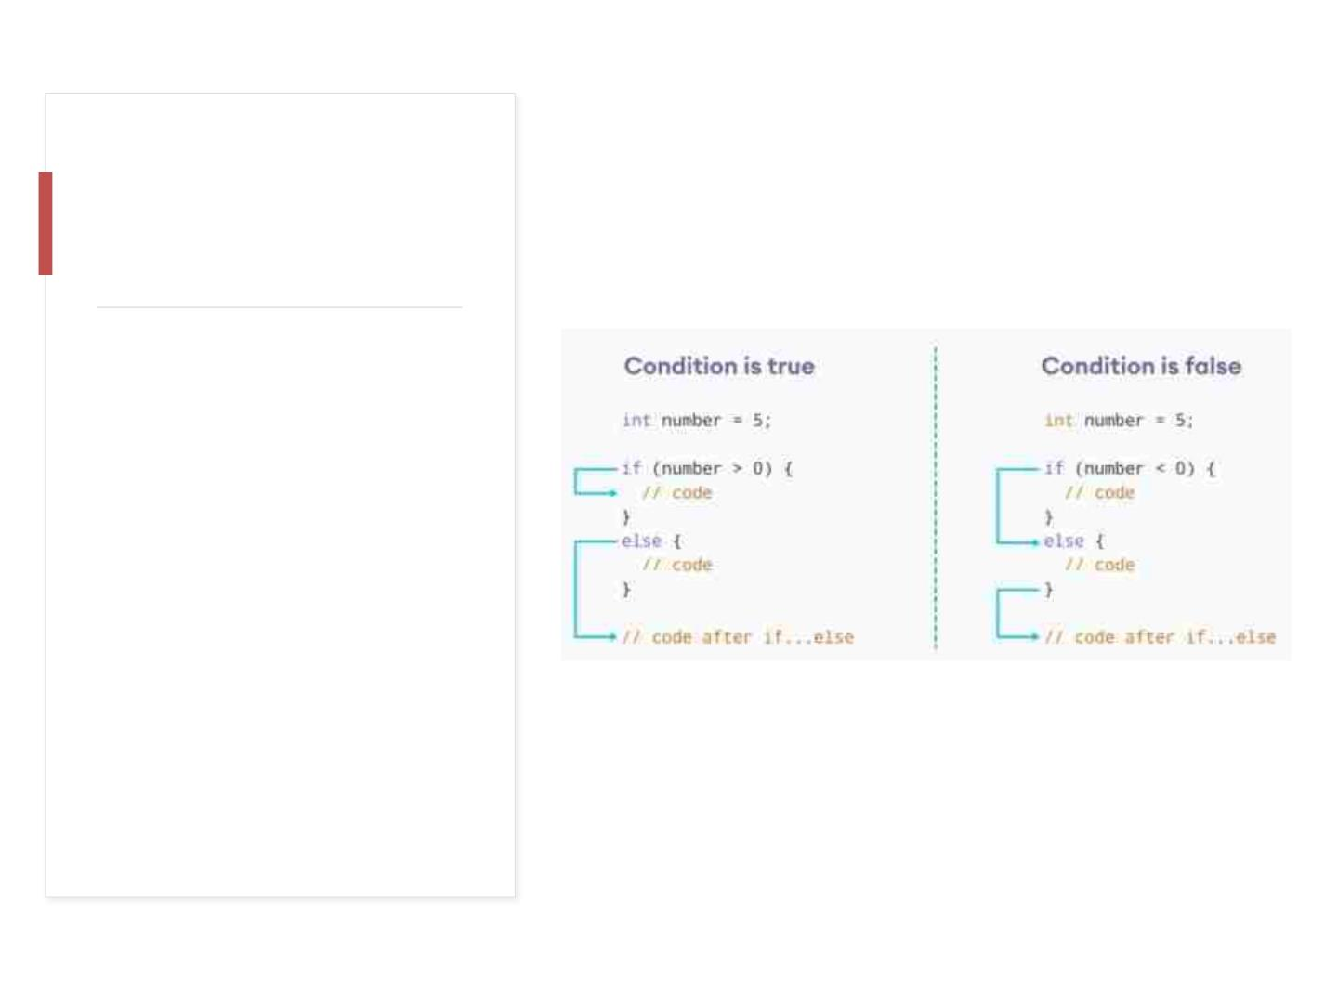
Howꢀtheꢀif...elseꢀ
statementꢀworks?

Slide 61

Javaꢀif...else...ifꢀ
Statement
Here,ꢀifꢀstatementsꢀareꢀexecutedꢀ
fromꢀtheꢀtopꢀtowardsꢀtheꢀbottom.ꢀ
Whenꢀtheꢀtestꢀconditionꢀisꢀtrue,ꢀ
codesꢀinsideꢀtheꢀbodyꢀofꢀ
thatꢀifꢀblockꢀisꢀexecuted.ꢀAnd,ꢀ
programꢀcontrolꢀjumpsꢀoutsideꢀ
theꢀif...else...ifꢀladder.
InꢀJava,ꢀweꢀhaveꢀ
anꢀif...else...ifꢀladder,ꢀthatꢀcanꢀbeꢀ
usedꢀtoꢀexecuteꢀoneꢀblockꢀofꢀcodeꢀ
amongꢀmultipleꢀotherꢀblocks.
Note:ꢀJavaꢀprovidesꢀaꢀspecialꢀ
operatorꢀcalledꢀternaryꢀoperator,ꢀ
whichꢀisꢀaꢀkindꢀofꢀshorthandꢀ
notationꢀofꢀif...else...ifꢀstatement.ꢀ
Toꢀlearnꢀaboutꢀtheꢀternaryꢀ
operator,ꢀvisitꢀJavaꢀTernaryꢀ
Operator.
Ifꢀallꢀtestꢀexpressionsꢀareꢀfalse,ꢀ
codesꢀinsideꢀtheꢀbodyꢀofꢀelseꢀareꢀ
executed.

Slide 62
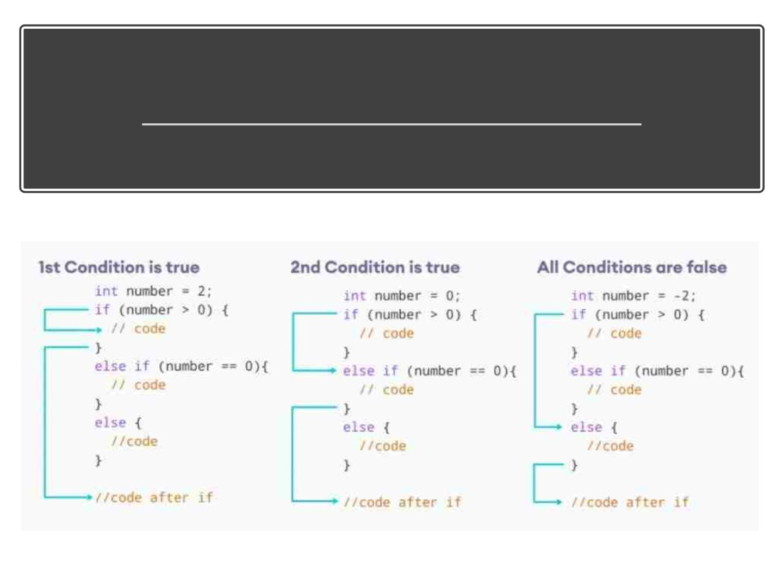
Howꢀtheꢀif...else...ifꢀladderꢀworks?

Slide 63
InꢀJava,ꢀitꢀisꢀalsoꢀpossibleꢀtoꢀ
useꢀif..ꢀelseꢀstatementsꢀinsideꢀ
anꢀif...ꢀelseꢀstatement.
It'sꢀcalledꢀtheꢀ
nestedꢀif...elseꢀstatement.
Here'sꢀaꢀprogramꢀtoꢀfindꢀtheꢀ
largestꢀofꢀ3ꢀnumbersꢀusingꢀ
theꢀnestedꢀif...elseꢀstatement.

Slide 64

Nestedꢀif...elseꢀ
Statementꢀ
Example
• Inꢀreal-worldꢀapplications,ꢀtheseꢀvaluesꢀ
mayꢀcomeꢀfromꢀuserꢀinputꢀdata,ꢀlogꢀfiles,ꢀ
formꢀsubmission,ꢀetc.

Slide 65
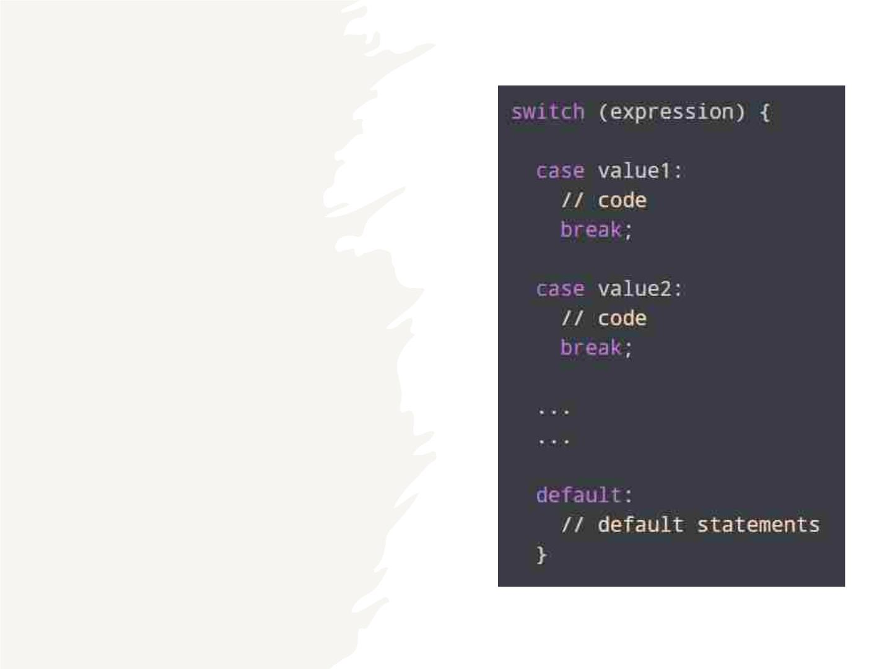
Javaꢀswitchꢀ
Statement
• Theꢀswitchꢀstatementꢀ
allowsꢀusꢀtoꢀexecuteꢀaꢀ
blockꢀofꢀcodeꢀamongꢀmanyꢀ
alternatives.

Slide 66
• Theꢀexpressionꢀisꢀevaluatedꢀonceꢀandꢀ
comparedꢀwithꢀtheꢀvaluesꢀofꢀeachꢀcase.
Howꢀdoesꢀ
theꢀ
switch-
caseꢀ
statementꢀ
work?
• Ifꢀexpressionꢀmatchesꢀwithꢀvalue1,ꢀtheꢀ
codeꢀofꢀcaseꢀvalue1ꢀareꢀexecuted.ꢀ
Similarly,ꢀtheꢀcodeꢀofꢀcaseꢀvalue2ꢀisꢀ
executedꢀifꢀexpressionꢀmatchesꢀ
withꢀvalue2.
• Ifꢀthereꢀisꢀnoꢀmatch,ꢀtheꢀcodeꢀofꢀ
theꢀdefaultꢀcaseꢀisꢀexecuted.
• Note:ꢀTheꢀworkingꢀofꢀtheꢀswitch-caseꢀ
statementꢀisꢀsimilarꢀtoꢀtheꢀJavaꢀ
if...else...ifꢀladder.ꢀHowever,ꢀtheꢀsyntaxꢀofꢀ
theꢀswitchꢀstatementꢀisꢀcleanerꢀandꢀ
muchꢀeasierꢀtoꢀreadꢀandꢀwrite.

Slide 67
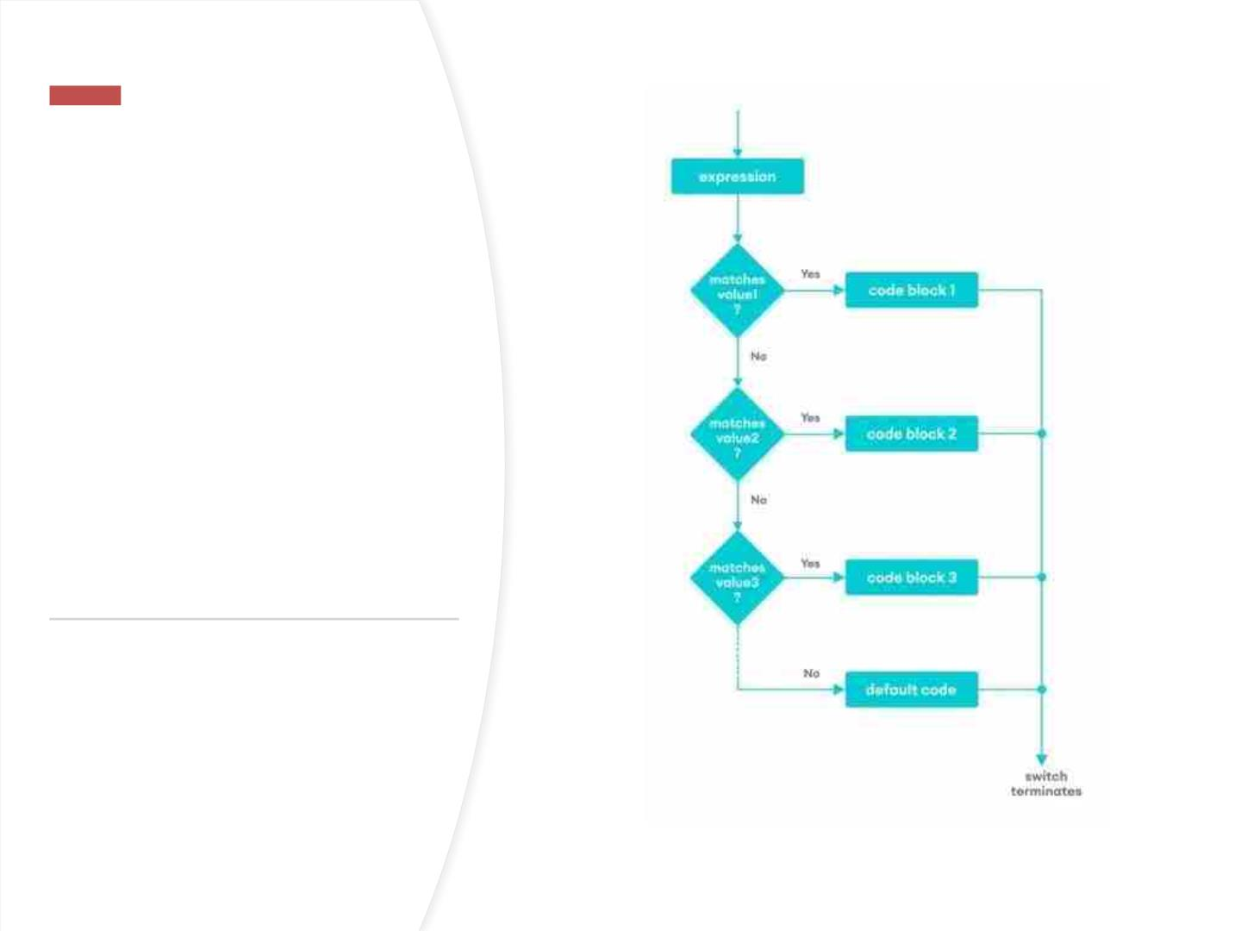
Flowchartꢀofꢀ
switchꢀ
Statement

Slide 68

Theꢀbreakꢀstatementꢀ
isꢀusedꢀtoꢀterminateꢀ
theꢀswitch-
breakꢀ
statementꢀinꢀ
Javaꢀ
caseꢀstatement.ꢀ
Ifꢀbreakꢀisꢀnotꢀused,ꢀ
allꢀtheꢀcasesꢀafterꢀtheꢀ
matchingꢀcaseꢀareꢀ
alsoꢀexecuted.
switch...case

Slide 69
defaultꢀ
caseꢀinꢀ
Javaꢀ
switch-
case
• Theꢀswitchꢀstatementꢀalsoꢀ
includesꢀanꢀoptionalꢀdefaultꢀ
case.ꢀItꢀisꢀexecutedꢀwhenꢀ
theꢀexpressionꢀdoesn'tꢀ
matchꢀanyꢀofꢀtheꢀcases.ꢀ

Slide 70

Exampleꢀforꢀswitchꢀ
case

Slide 71

JavaꢀforꢀLoop
• Inꢀcomputerꢀprogramming,ꢀloopsꢀareꢀ
usedꢀtoꢀrepeatꢀaꢀblockꢀofꢀcode.ꢀForꢀ
example,ꢀifꢀyouꢀwantꢀtoꢀshowꢀaꢀ
messageꢀ100ꢀtimes,ꢀthenꢀratherꢀthanꢀ
typingꢀtheꢀsameꢀcodeꢀ100ꢀtimes,ꢀyouꢀ
canꢀuseꢀaꢀloop.
• InꢀJava,ꢀthereꢀareꢀthreeꢀtypesꢀofꢀloops.
– forꢀloop
– whileꢀloop
– do...whileꢀloop

Slide 72

JavaꢀforꢀLoop
Javaꢀforꢀloopꢀisꢀusedꢀtoꢀrunꢀaꢀ
blockꢀofꢀcodeꢀforꢀaꢀcertainꢀ
numberꢀofꢀtimes.ꢀ
TheꢀinitialExpressionꢀinitializesꢀ
and/orꢀdeclaresꢀvariablesꢀandꢀ
executesꢀonlyꢀonce.
Theꢀconditionꢀisꢀevaluated.ꢀIfꢀ
theꢀconditionꢀisꢀtrue,ꢀtheꢀbodyꢀ
ofꢀtheꢀforꢀloopꢀisꢀexecuted.
TheꢀupdateExpressionꢀupdatesꢀ
theꢀvalueꢀofꢀinitialExpression.
Theꢀconditionꢀisꢀevaluatedꢀ
again.ꢀTheꢀprocessꢀcontinuesꢀ
untilꢀtheꢀconditionꢀisꢀfalse.

Slide 73
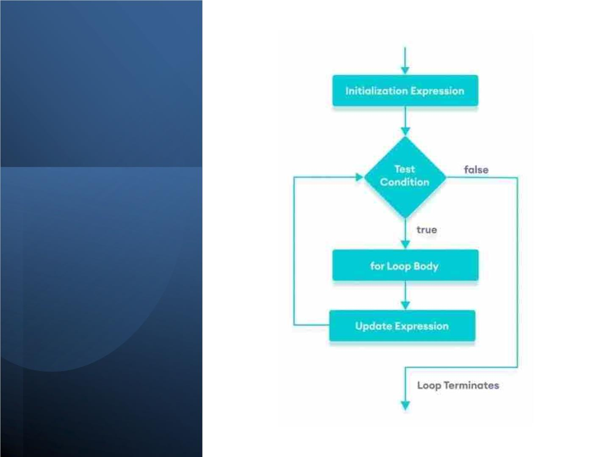

Slide 74
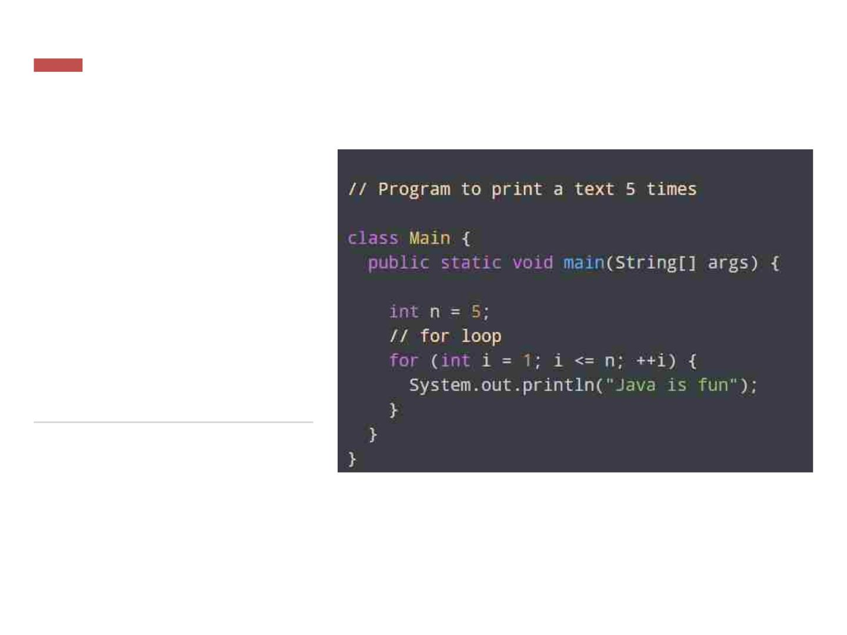
Exampleꢀ1:ꢀ
Displayꢀaꢀ
TextꢀFiveꢀ
Times

Slide 75
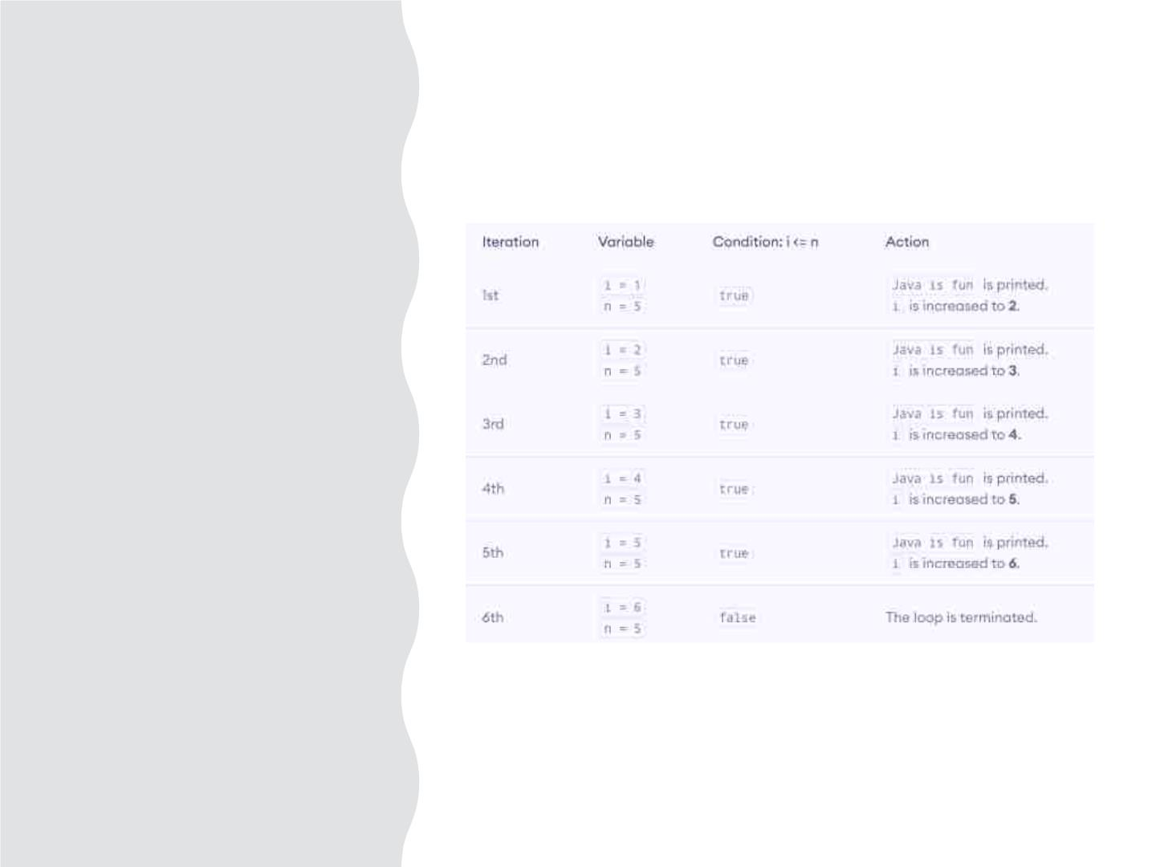
Howꢀ
aboveꢀ
Codeꢀ
works

Slide 76
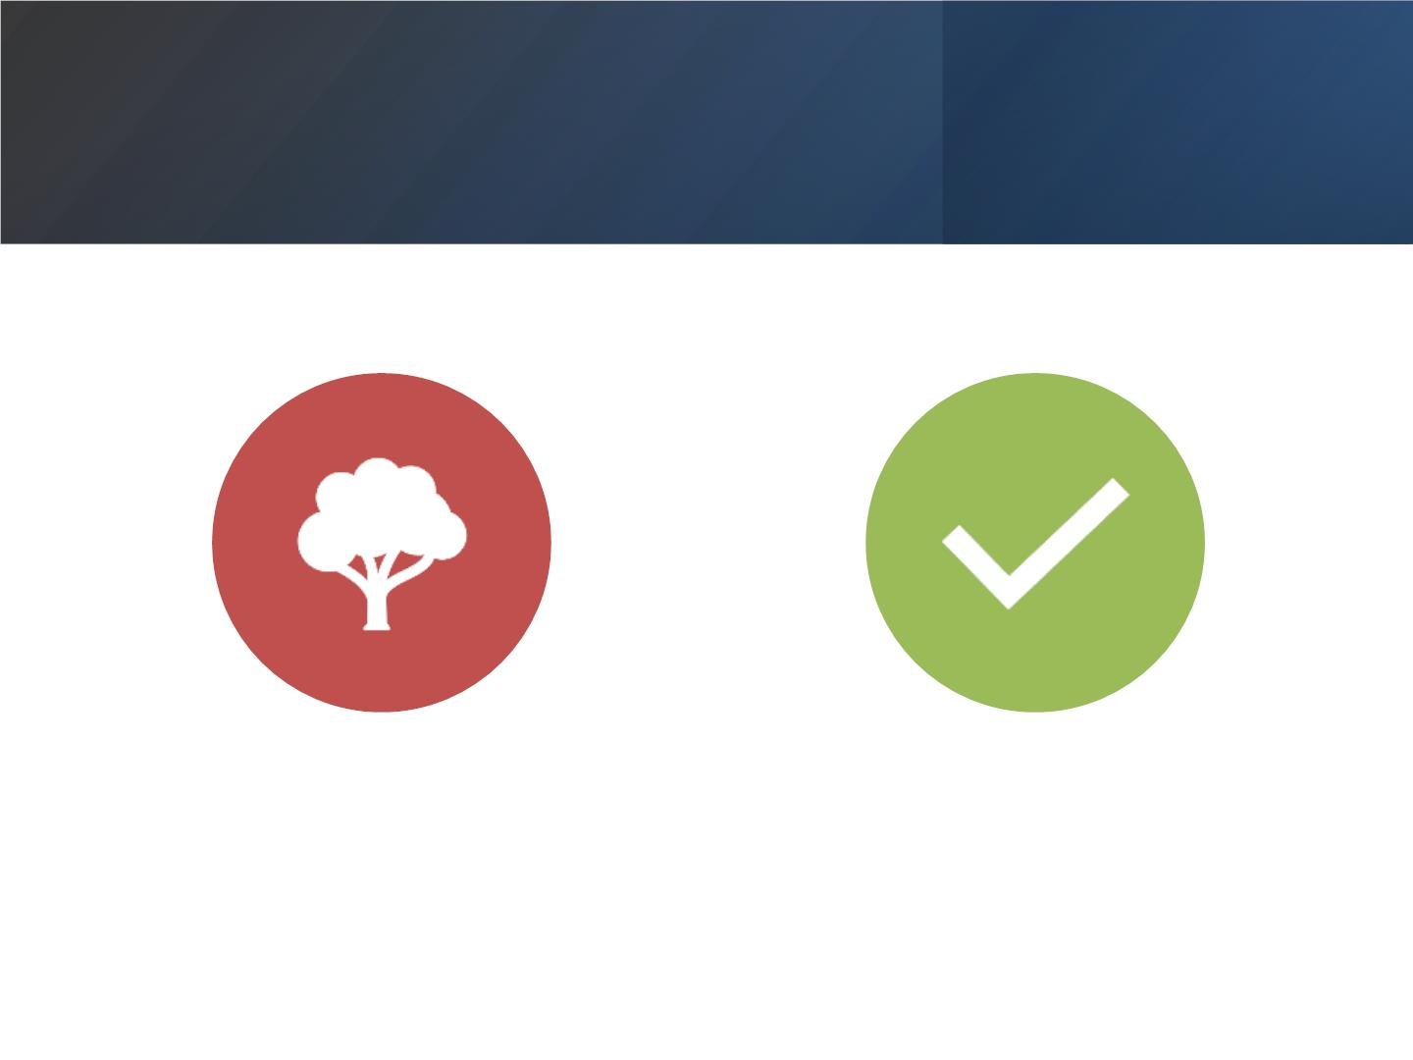
DISPLAYꢀSUMꢀOFꢀNꢀ
NATURALꢀNUMBERS
DISPLAYꢀNUMBERSꢀFROMꢀ1ꢀ
TOꢀ5

Slide 77
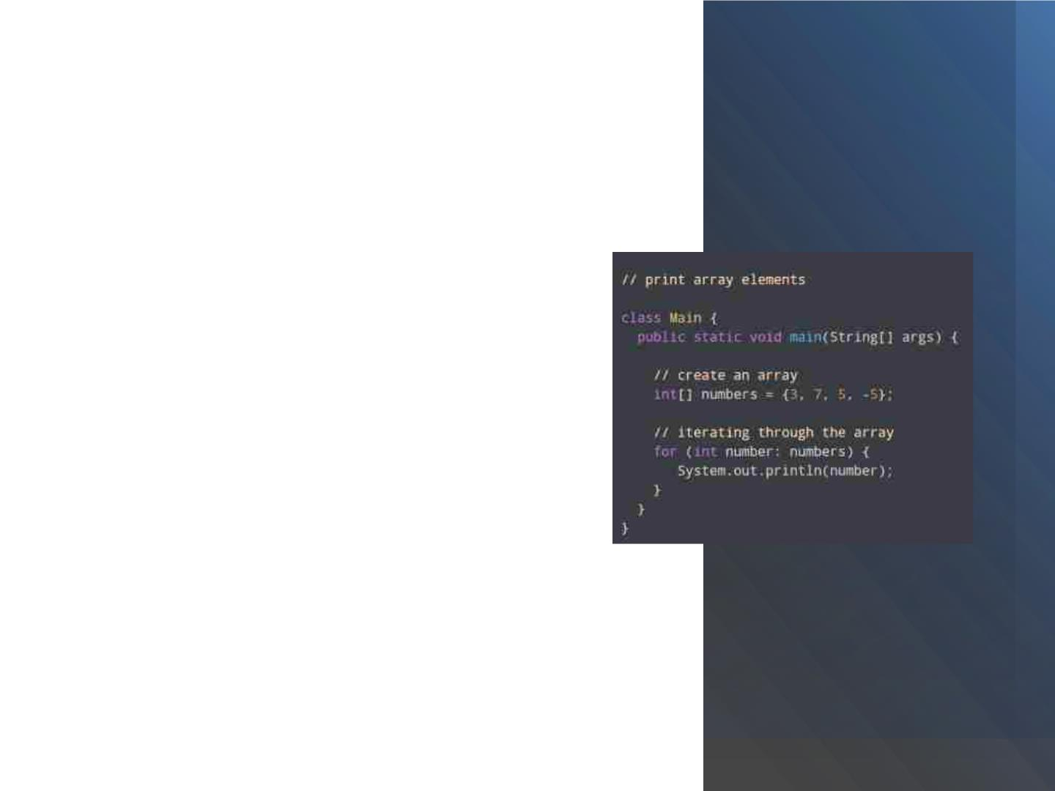
Javaꢀfor-eachꢀLoop
• TheꢀJavaꢀforꢀloopꢀhasꢀanꢀalternativeꢀ
syntaxꢀthatꢀmakesꢀitꢀeasyꢀtoꢀiterateꢀ
throughꢀarraysꢀandꢀcollections.ꢀ
• Forꢀexample,
• Here,ꢀweꢀhaveꢀusedꢀtheꢀfor-eachꢀ
loopꢀtoꢀprintꢀeachꢀelementꢀofꢀ
theꢀnumbersꢀarrayꢀoneꢀbyꢀone.
• Inꢀtheꢀfirstꢀiterationꢀofꢀtheꢀ
loop,ꢀnumberꢀwillꢀbeꢀ3,ꢀnumberꢀwillꢀbeꢀ
7ꢀinꢀsecondꢀiterationꢀandꢀsoꢀon.

Slide 78
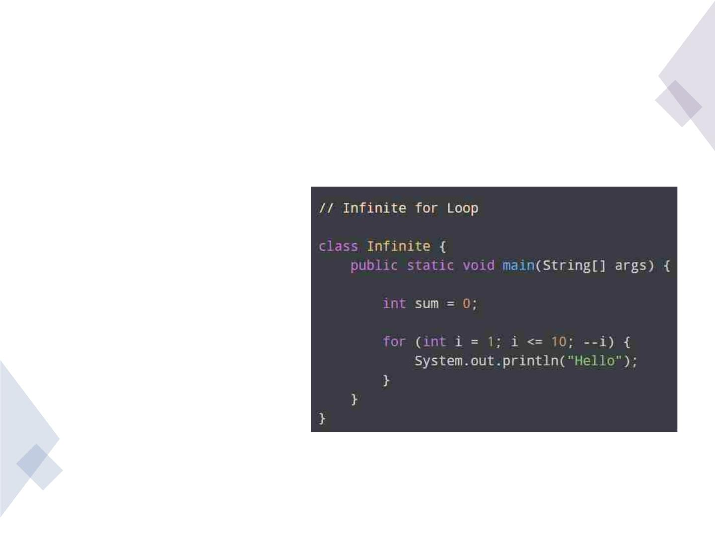
JavaꢀInfiniteꢀforꢀLoop
• Ifꢀweꢀsetꢀtheꢀtestꢀ
expressionꢀinꢀsuchꢀaꢀwayꢀ
thatꢀitꢀneverꢀevaluatesꢀ
toꢀfalse,ꢀtheꢀforꢀloopꢀwillꢀrunꢀ
forever.ꢀ
• Thisꢀisꢀcalledꢀinfiniteꢀforꢀ
loop.ꢀForꢀexample,

Slide 79
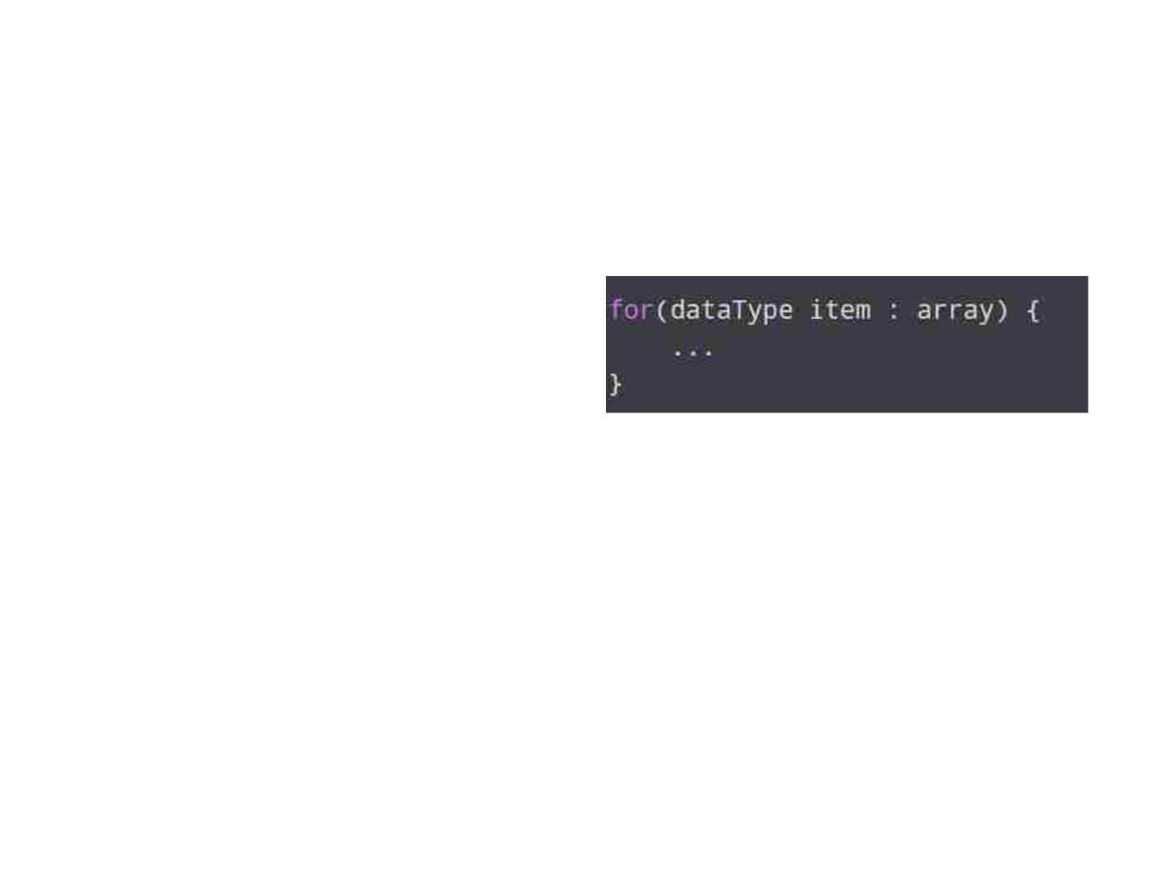
Javaꢀfor-eachꢀLoop
• InꢀJava,ꢀtheꢀfor-eachꢀloopꢀ • for-eachꢀLoopꢀSyntax
isꢀusedꢀtoꢀiterateꢀthroughꢀ
elementsꢀofꢀarraysꢀandꢀ
collectionsꢀ(likeꢀArrayList).ꢀ
Itꢀisꢀalsoꢀknownꢀasꢀtheꢀ
enhancedꢀforꢀloop.
• arrayꢀ-ꢀanꢀarrayꢀorꢀaꢀ
collection
• itemꢀ-ꢀeachꢀitemꢀofꢀ
array/collectionꢀisꢀassignedꢀ
toꢀthisꢀvariable
• dataTypeꢀ-ꢀtheꢀdataꢀtypeꢀofꢀ
theꢀarray/collection

Slide 80
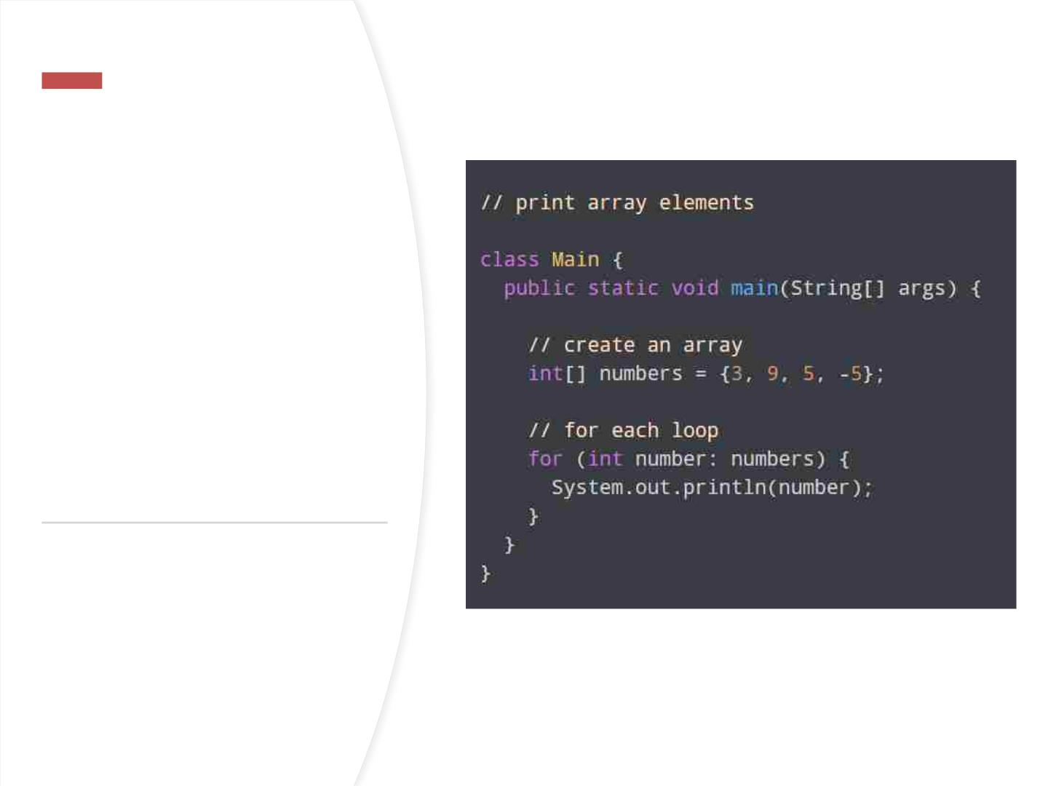
ForꢀEachꢀ
exampleꢀ-ꢀ
PrintꢀArrayꢀ
Elements

Slide 81
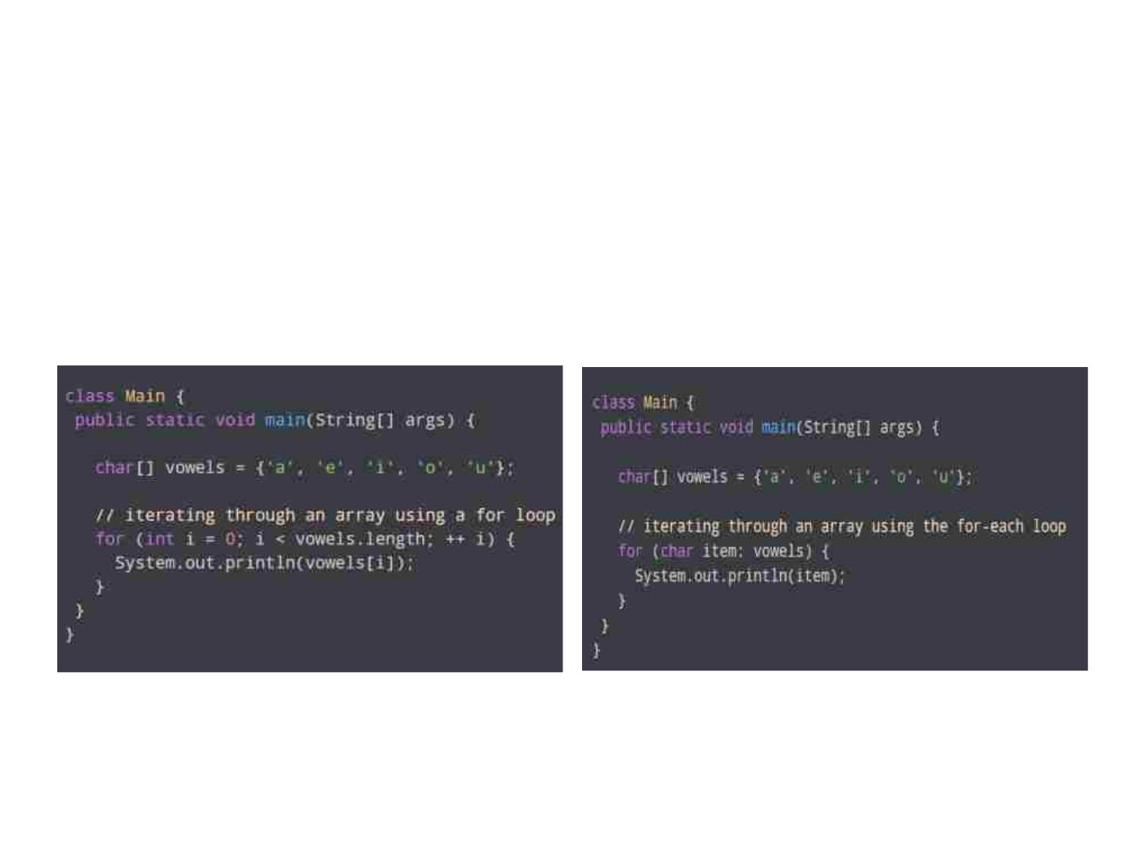
forꢀloopꢀVsꢀfor-eachꢀloop
Usingꢀforꢀloop
Usingꢀfor-eachꢀLoop

Slide 82
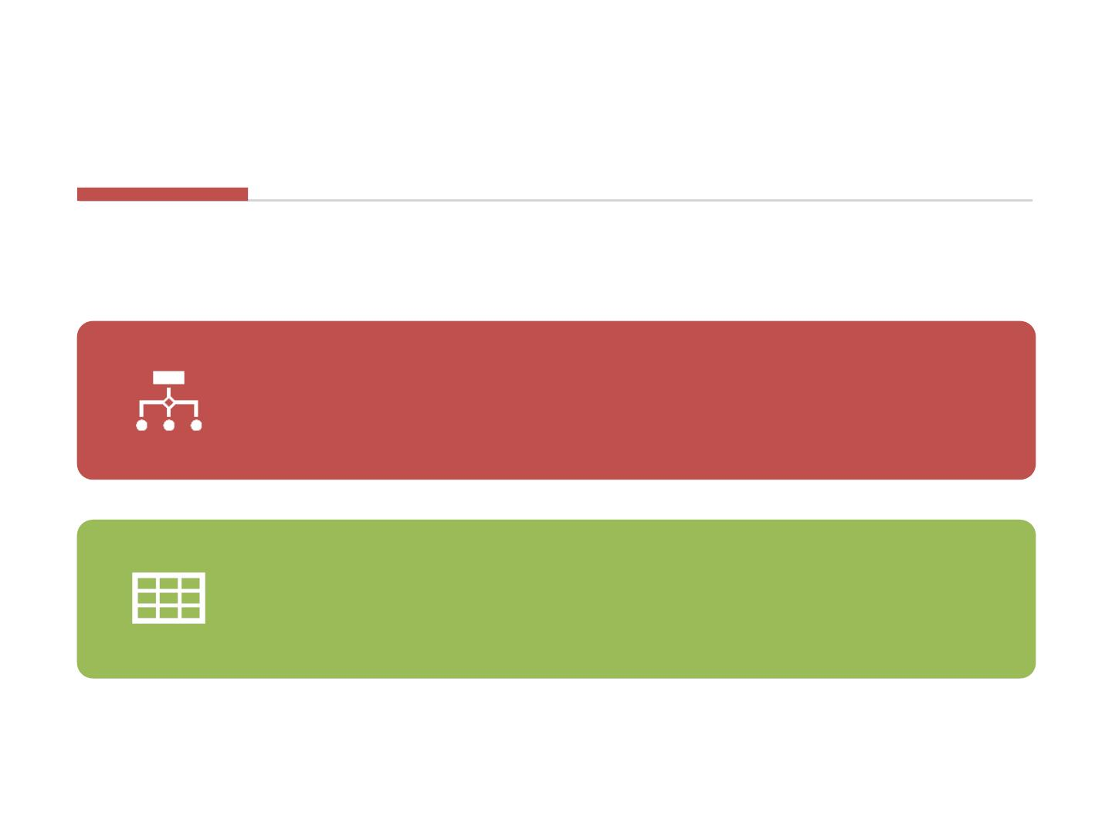
forꢀloopꢀVsꢀfor-eachꢀloop
Here,ꢀtheꢀoutputꢀofꢀbothꢀprogramsꢀisꢀtheꢀsame.ꢀ
However,ꢀtheꢀfor-eachꢀloopꢀisꢀeasierꢀtoꢀwriteꢀandꢀ
understand.
Thisꢀisꢀwhyꢀtheꢀfor-eachꢀloopꢀisꢀpreferredꢀoverꢀ
theꢀforꢀloopꢀwhenꢀworkingꢀwithꢀarraysꢀandꢀ
collections.

Slide 83
• Inꢀcomputerꢀprogramming,ꢀ
loopsꢀareꢀusedꢀtoꢀrepeatꢀaꢀ
blockꢀofꢀcode.ꢀForꢀexample,ꢀ
ifꢀyouꢀwantꢀtoꢀshowꢀaꢀ
messageꢀ100ꢀtimes,ꢀthenꢀ
youꢀcanꢀuseꢀaꢀloop.ꢀIt'sꢀjustꢀ
aꢀsimpleꢀexample;ꢀyouꢀcanꢀ
achieveꢀmuchꢀmoreꢀwithꢀ
loops.
whileꢀandꢀ
do...whileꢀ
Loop

Slide 84
• Javaꢀwhileꢀloopꢀisꢀ
usedꢀtoꢀrunꢀaꢀspecificꢀ
codeꢀuntilꢀaꢀcertainꢀ
conditionꢀisꢀmet.
Javaꢀ
whileꢀ
loop

Slide 85
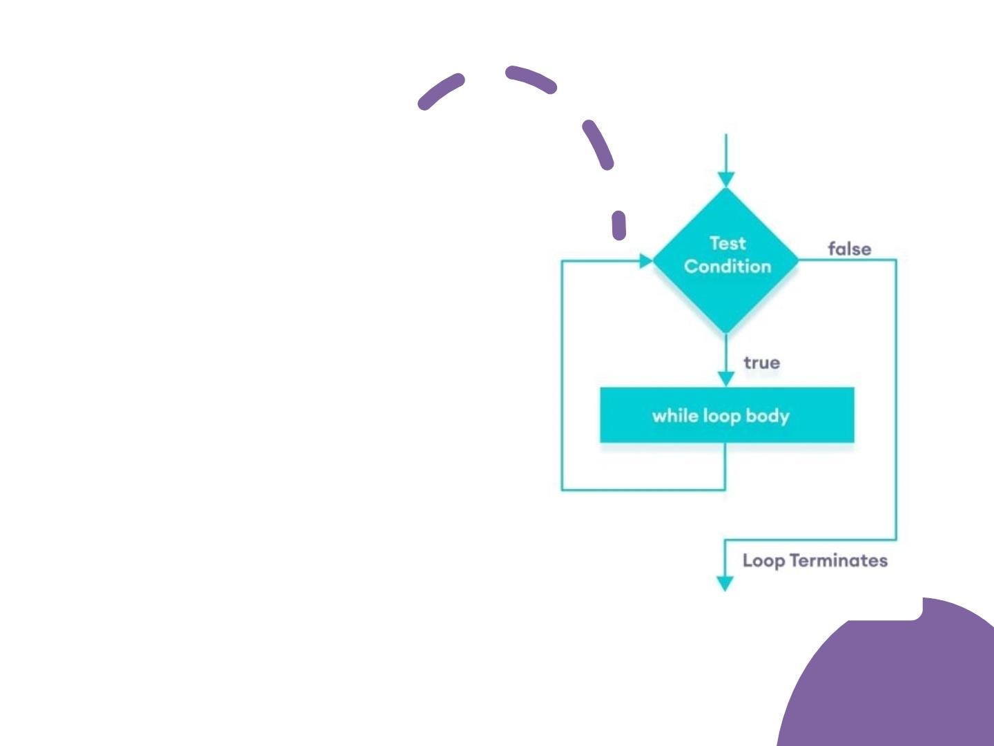
Flowchartꢀofꢀ
whileꢀloop
• Aꢀwhileꢀloopꢀevaluatesꢀ
theꢀtextExpressionꢀinsideꢀtheꢀ
parenthesisꢀ().
• IfꢀtheꢀtextExpressionꢀevaluatesꢀ
toꢀtrue,ꢀtheꢀcodeꢀinsideꢀ
theꢀwhileꢀloopꢀisꢀexecuted.
• TheꢀtextExpressionꢀisꢀevaluatedꢀ
again.
• Thisꢀprocessꢀcontinuesꢀuntilꢀ
theꢀtextExpressionꢀisꢀfalse.
• Whenꢀ
theꢀtextExpressionꢀevaluatesꢀ
toꢀfalse,ꢀtheꢀloopꢀstops.

Slide 86

•
Theꢀdo...whileꢀloopꢀisꢀsimilarꢀ
toꢀwhileꢀloop.ꢀHowever,ꢀtheꢀ
bodyꢀofꢀdo...whileꢀloopꢀisꢀ
executedꢀonceꢀbeforeꢀtheꢀ
testꢀexpressionꢀisꢀchecked.
Javaꢀdo...whileꢀ
loop

Slide 87
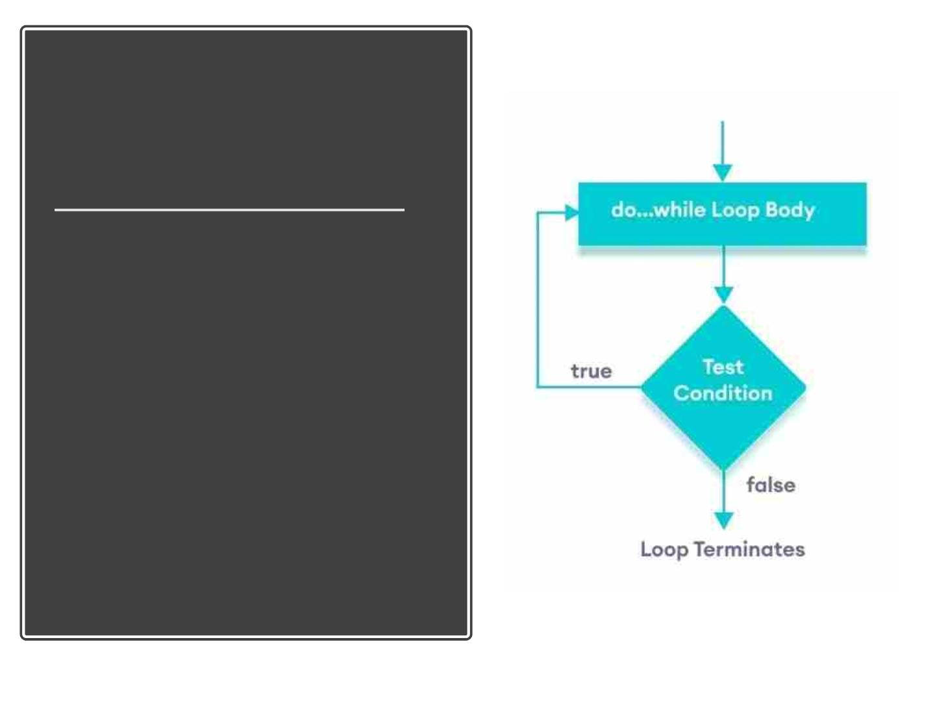
Javaꢀdo...whileꢀloop
• Theꢀbodyꢀofꢀtheꢀloopꢀisꢀexecutedꢀatꢀ
first.ꢀ
• ThenꢀtheꢀtextExpressionꢀisꢀevaluated.
• IfꢀtheꢀtextExpressionꢀevaluatesꢀtoꢀtrue,ꢀ
theꢀbodyꢀofꢀtheꢀloopꢀinsideꢀ
theꢀdoꢀstatementꢀisꢀexecutedꢀagain.
• TheꢀtextExpressionꢀisꢀevaluatedꢀonceꢀ
again
• .IfꢀtheꢀtextExpressionꢀevaluatesꢀ
toꢀtrue,ꢀtheꢀbodyꢀofꢀtheꢀloopꢀinsideꢀ
theꢀdoꢀstatementꢀisꢀexecutedꢀagain.
• Thisꢀprocessꢀcontinuesꢀuntilꢀ
theꢀtextExpressionꢀevaluatesꢀtoꢀfalse.ꢀ
Thenꢀtheꢀloopꢀstops.

Slide 88
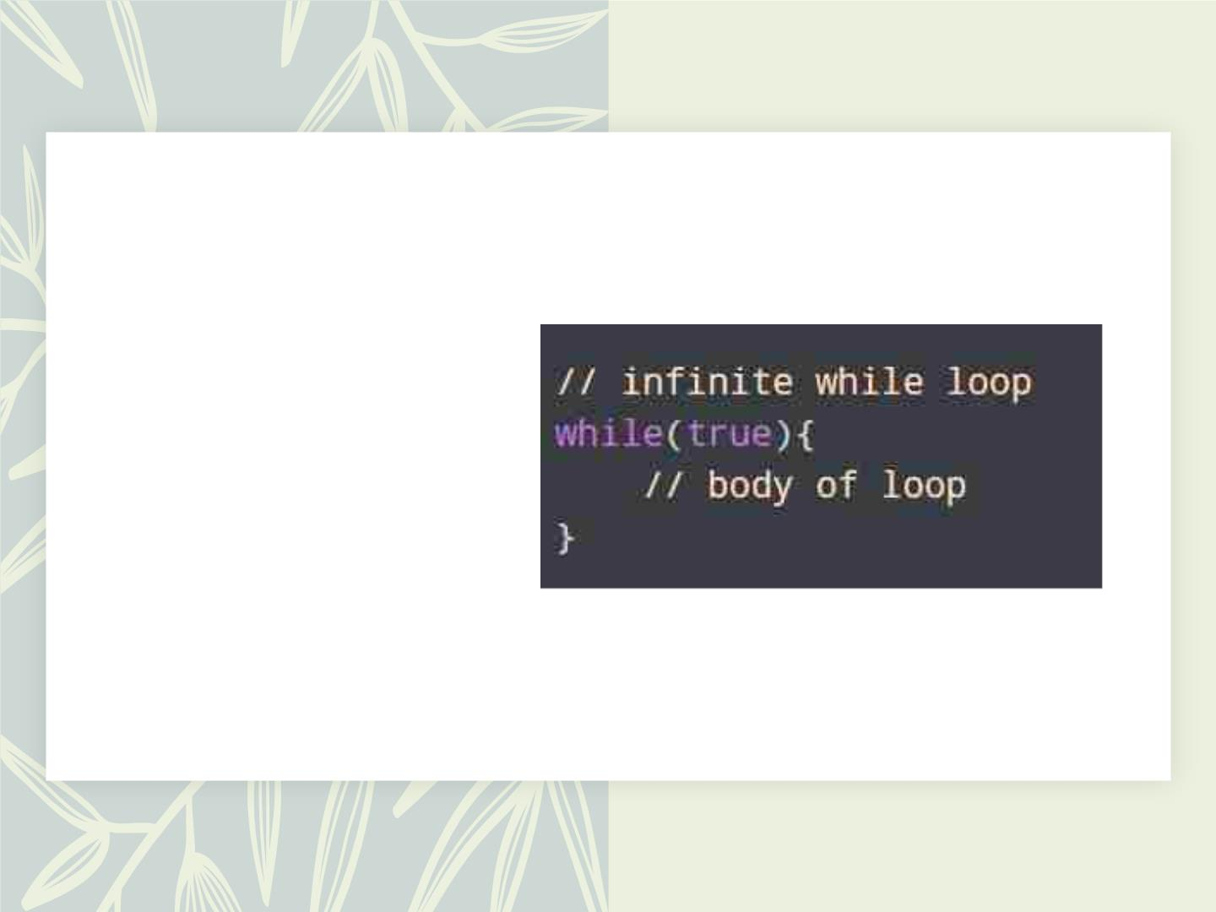
Infiniteꢀwhileꢀ
loop
• Ifꢀtheꢀconditionꢀofꢀaꢀloopꢀ
isꢀalwaysꢀtrue,ꢀtheꢀloopꢀ
runsꢀforꢀinfiniteꢀtimesꢀ
(untilꢀtheꢀmemoryꢀisꢀfull).

Slide 89

Breakꢀ&ꢀContinue
Whileꢀworkingꢀwithꢀloops,ꢀitꢀ
isꢀsometimesꢀdesirableꢀtoꢀ
skipꢀsomeꢀstatementsꢀinsideꢀ
theꢀloopꢀorꢀterminateꢀtheꢀ
loopꢀimmediatelyꢀwithoutꢀ
checkingꢀtheꢀtestꢀexpression.
Inꢀsuchꢀcases,ꢀbreakꢀandꢀ
continueꢀstatementsꢀareꢀ
used.

Slide 90
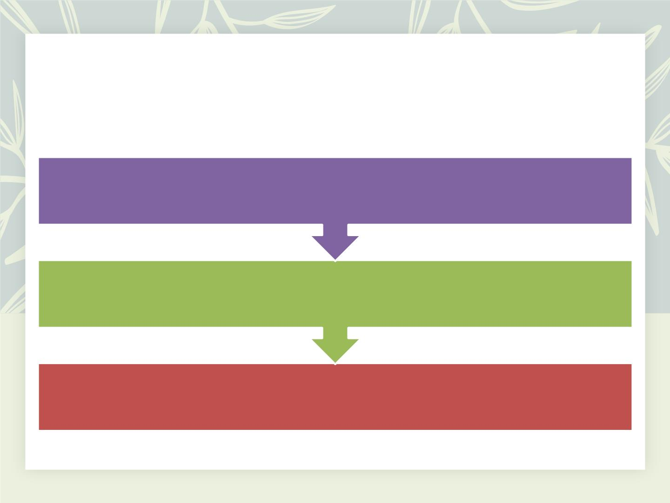
JavaꢀbreakꢀStatement
TheꢀbreakꢀstatementꢀinꢀJavaꢀterminatesꢀtheꢀloopꢀimmediately,ꢀandꢀtheꢀ
controlꢀofꢀtheꢀprogramꢀmovesꢀtoꢀtheꢀnextꢀstatementꢀfollowingꢀtheꢀloop.
Itꢀisꢀalmostꢀalwaysꢀusedꢀwithꢀdecision-makingꢀstatementsꢀ(Javaꢀif...elseꢀ
Statement).
Syntaxꢀ:ꢀꢀbreak;

Slide 91
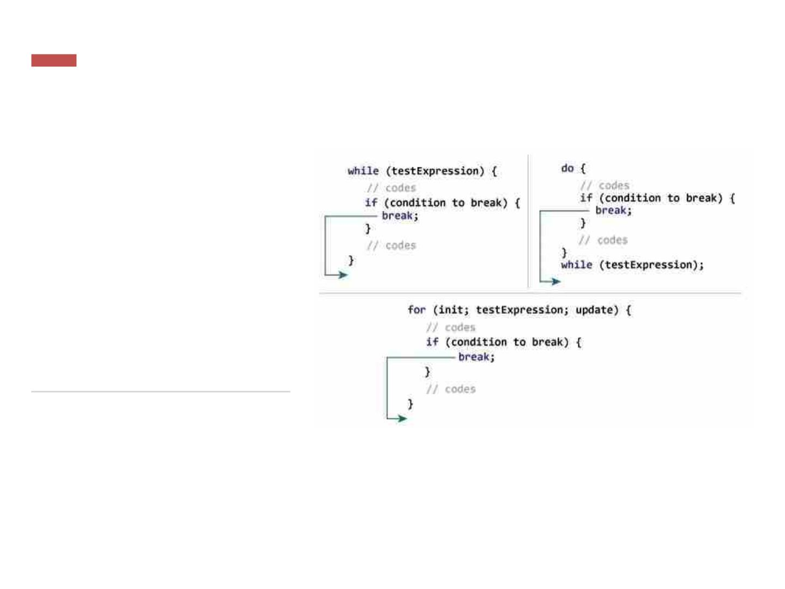
Howꢀbreakꢀ
statementꢀ
works?

Slide 92
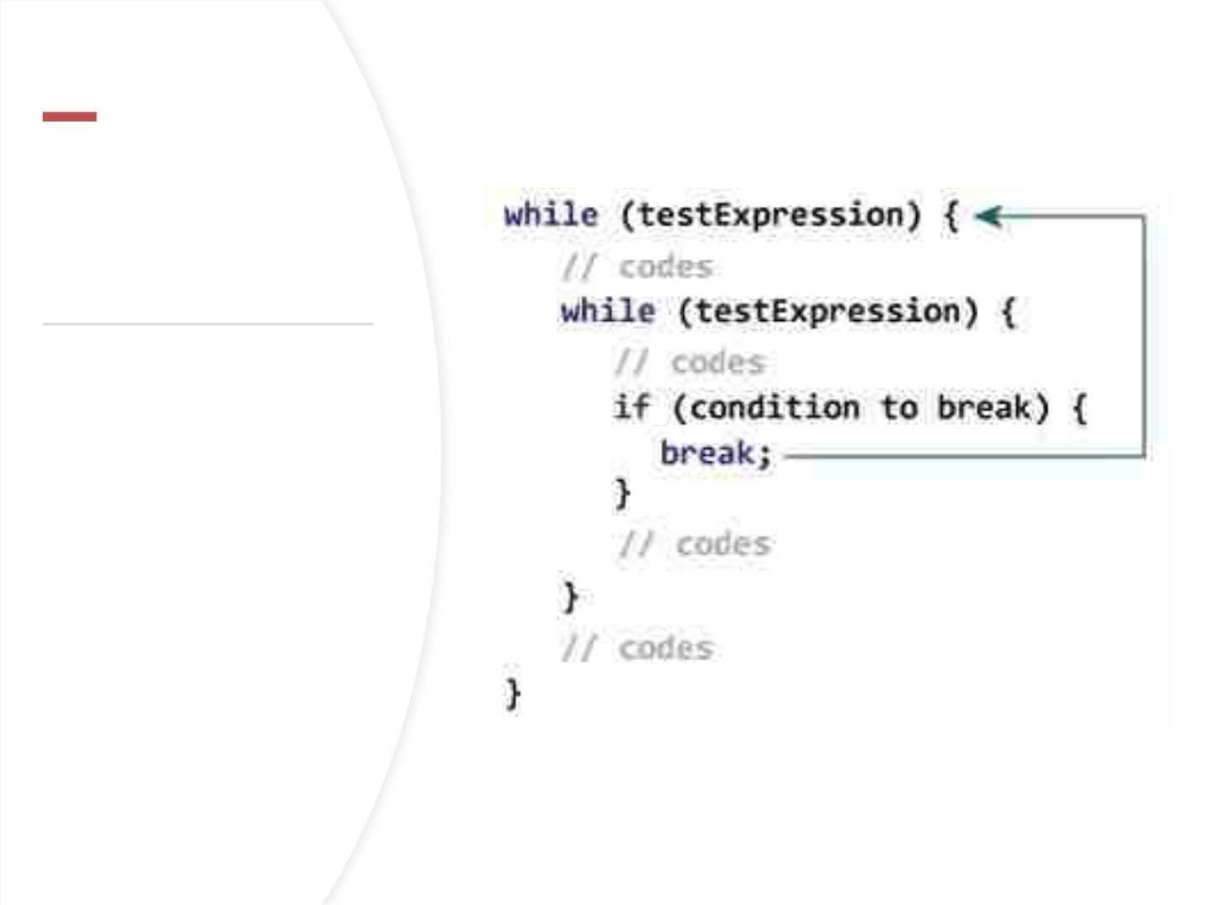
Javaꢀbreakꢀandꢀ
NestedꢀLoop
• Inꢀtheꢀcaseꢀofꢀnestedꢀ
loops,ꢀtheꢀbreakꢀ
statementꢀterminatesꢀtheꢀ
innermostꢀloop.
• Here,ꢀtheꢀbreakꢀstatementꢀ
terminatesꢀtheꢀinnermostꢀ
whileꢀloop,ꢀandꢀcontrolꢀ
jumpsꢀtoꢀtheꢀouterꢀloop.

Slide 93
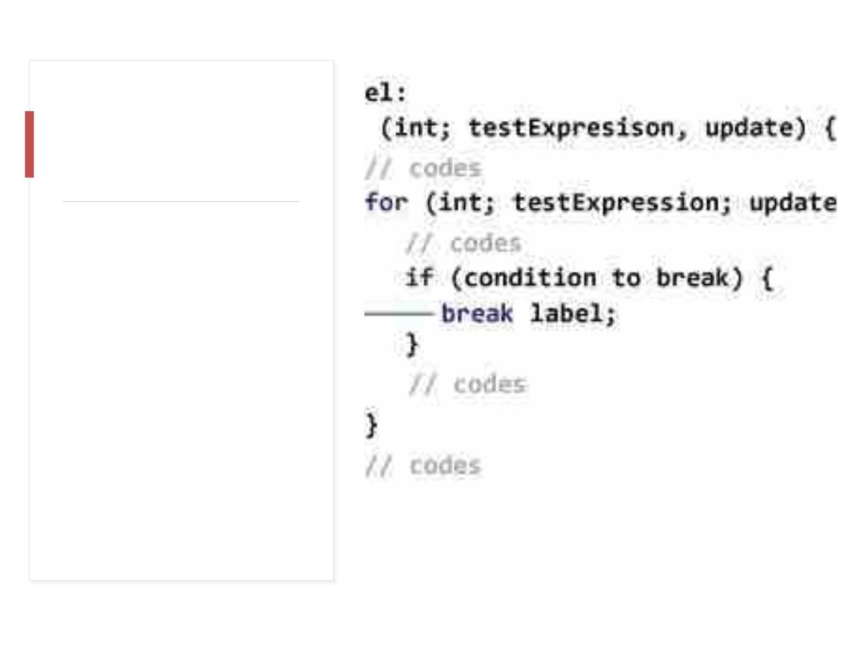
Labeledꢀbreakꢀ
Statement
• Weꢀcanꢀuseꢀtheꢀlabeledꢀ
breakꢀstatementꢀtoꢀ
terminateꢀtheꢀoutermostꢀ
loopꢀasꢀwell.
• Note:ꢀ
Theꢀbreakꢀstatementꢀisꢀ
alsoꢀusedꢀtoꢀterminateꢀ
casesꢀinsideꢀ
theꢀswitchꢀstatement.ꢀ

Slide 94

THEꢀCONTINUEꢀSTATEMENTꢀSKIPSꢀTHEꢀ
CURRENTꢀITERATIONꢀOFꢀAꢀLOOPꢀ
(FOR,ꢀWHILE,ꢀDO...WHILE,ꢀETC).
AFTERꢀTHEꢀCONTINUEꢀSTATEMENT,ꢀTHEꢀ
PROGRAMꢀMOVESꢀTOꢀTHEꢀENDꢀOFꢀTHEꢀ
LOOP.ꢀAND,ꢀTESTꢀEXPRESSIONꢀISꢀ
THEꢀCONTINUEꢀSTATEMENTꢀISꢀALMOSTꢀ
ALWAYSꢀUSEDꢀINꢀDECISION-MAKINGꢀ
STATEMENTSꢀ(IF...ELSEꢀSTATEMENT).
EVALUATEDꢀ(UPDATEꢀSTATEMENTꢀISꢀ
EVALUATEDꢀINꢀCASEꢀOFꢀTHEꢀFORꢀLOOP).

Slide 95
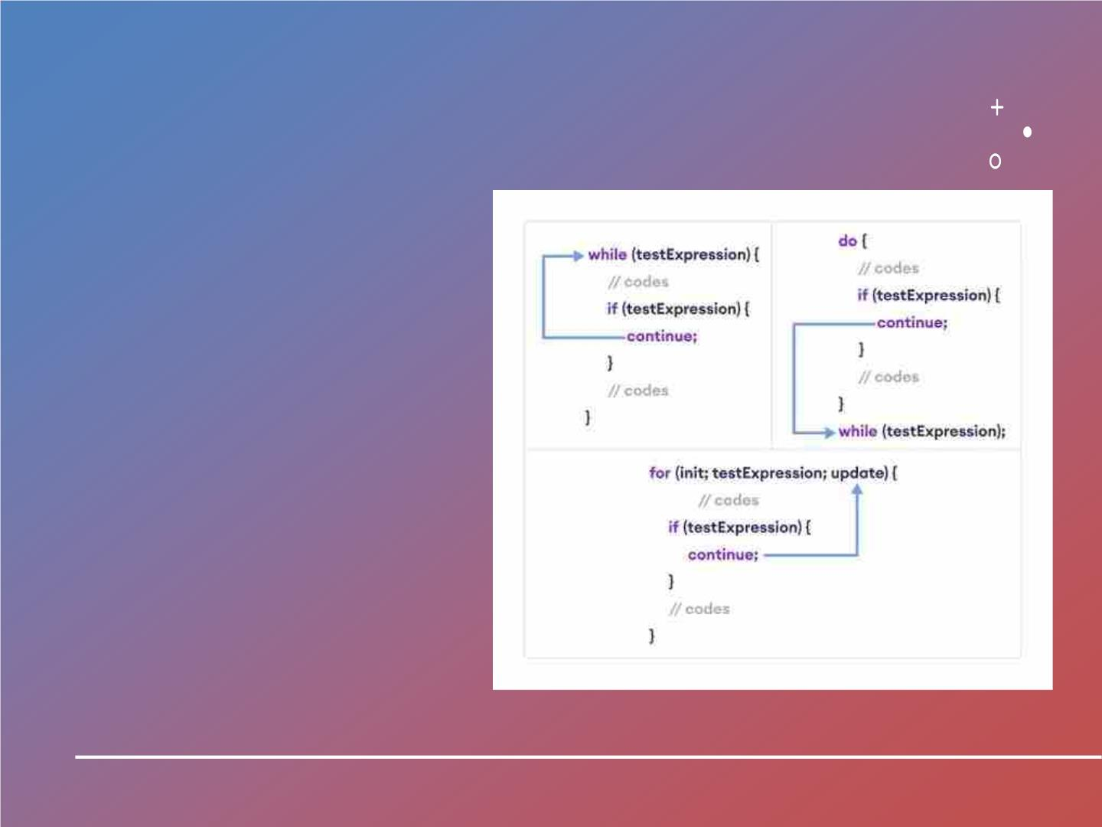

Slide 96


Slide 97

Arraysꢀ
Declare,ꢀ
Create,ꢀ
Initialize

Slide 98

WhatꢀisꢀJavaꢀ
Array?
JAVAꢀARRAYꢀISꢀAꢀVERYꢀCOMMONꢀTYPEꢀ
OFꢀDATAꢀSTRUCTUREꢀWHICHꢀCONTAINSꢀ
ALLꢀTHEꢀDATAꢀVALUESꢀOFꢀTHEꢀSAMEꢀ
DATAꢀTYPE.ꢀ
THEꢀDATAꢀITEMSꢀPUTꢀINꢀTHEꢀARRAYꢀAREꢀ
CALLEDꢀELEMENTSꢀANDꢀTHEꢀFIRSTꢀ
ELEMENTꢀINꢀTHEꢀARRAYꢀSTARTSꢀWITHꢀ
INDEXꢀZERO.ꢀ
ARRAYSꢀINHERITꢀTHEꢀOBJECTꢀCLASSꢀ
ANDꢀIMPLEMENTꢀTHEꢀSERIALIZABLEꢀ
ANDꢀCLONEABLEꢀINTERFACES.ꢀWEꢀCANꢀ
STOREꢀPRIMITIVEꢀVALUESꢀORꢀOBJECTSꢀ
INꢀANꢀARRAY.

Slide 99

ArrayꢀVariables
Usingꢀanꢀarrayꢀinꢀ
yourꢀprogramꢀisꢀaꢀ3ꢀ
stepꢀprocessꢀ–
DeclaringꢀyourꢀArray
Constructingꢀyourꢀ
Array
InitializeꢀyourꢀArray

Slide 100
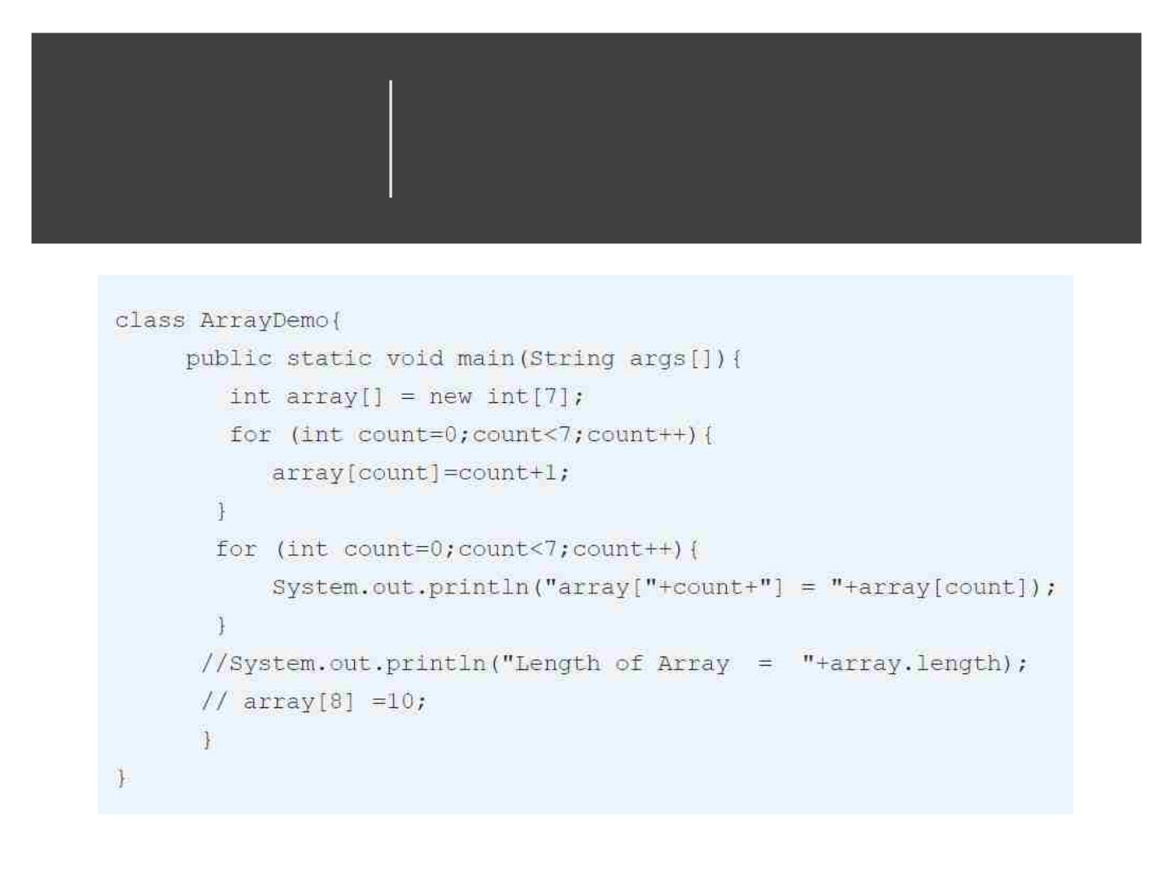
ArrayꢀProgram

Slide 101
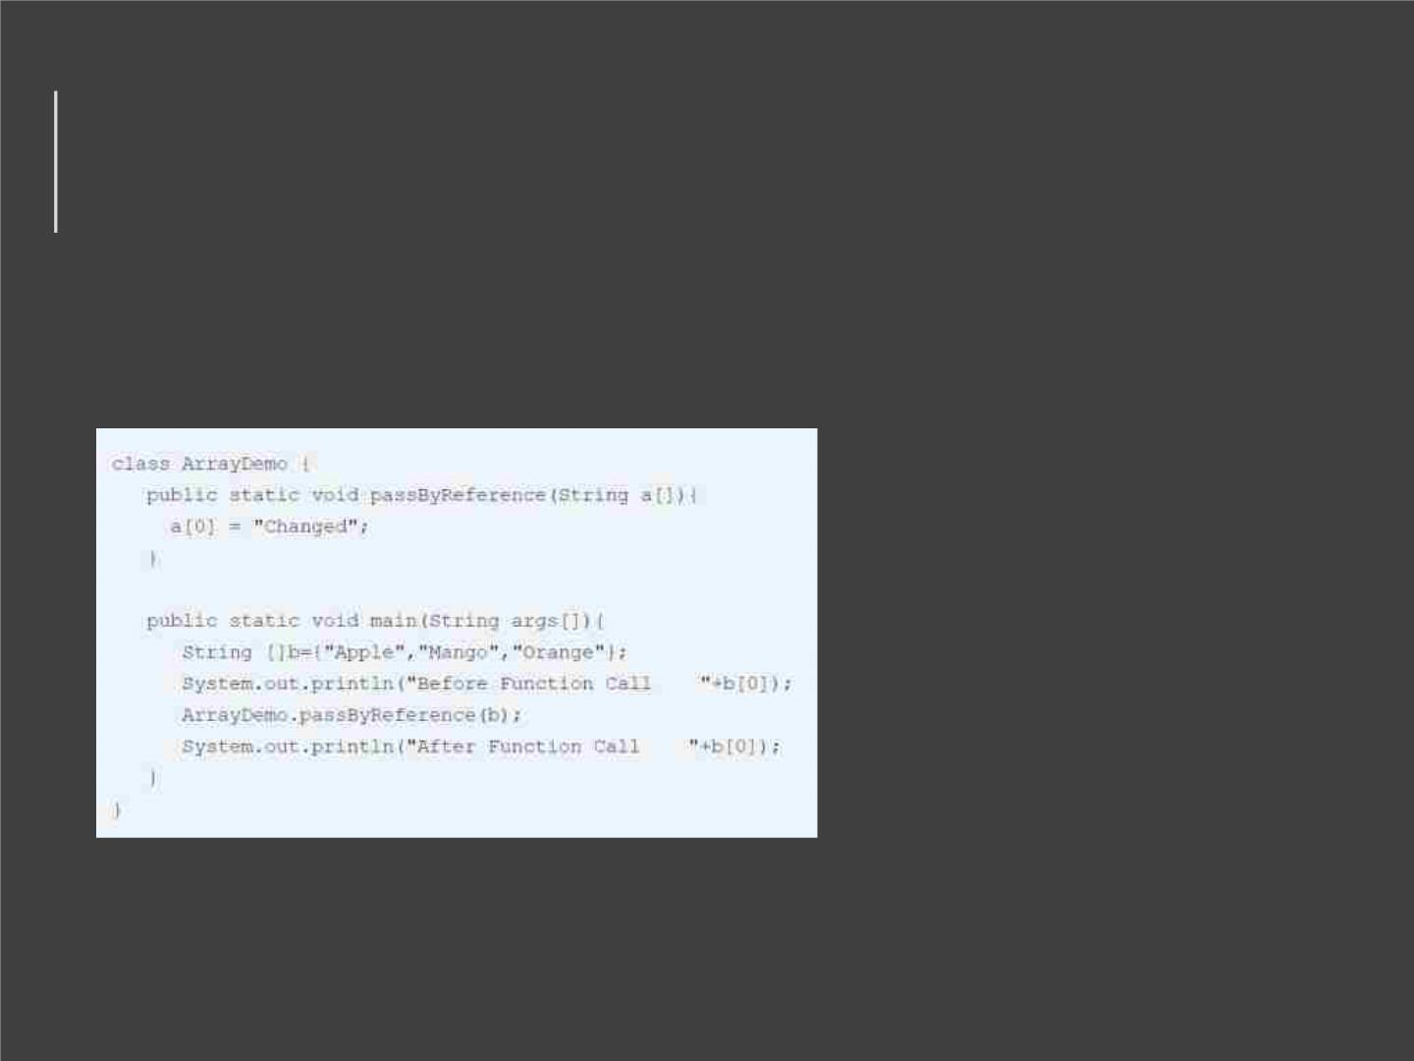
JavaꢀArray:ꢀPassꢀbyꢀreference
• Arraysꢀareꢀpassedꢀtoꢀ
functionsꢀbyꢀreference,ꢀ
orꢀasꢀaꢀpointerꢀtoꢀtheꢀ
original.ꢀThisꢀmeansꢀ
anythingꢀyouꢀdoꢀtoꢀtheꢀ
Arrayꢀinsideꢀthe
functionꢀaffectsꢀtheꢀ
original.

Slide 102

Multidimensionalꢀ
arrays
•
•
Multidimensionalꢀarraysꢀareꢀ
actuallyꢀarraysꢀofꢀarrays.ꢀToꢀ
declareꢀaꢀmultidimensionalꢀ
arrayꢀvariable,ꢀspecifyꢀeachꢀ
additionalꢀindexꢀusingꢀ
anotherꢀsetꢀofꢀsquareꢀ
brackets.
Whenꢀyouꢀallocateꢀmemoryꢀ
forꢀaꢀmultidimensionalꢀ
array,ꢀyouꢀneedꢀonlyꢀspecifyꢀ
theꢀmemoryꢀforꢀtheꢀfirstꢀ
(leftmost)ꢀdimension.
•
•
Youꢀcanꢀallocateꢀtheꢀ
remainingꢀdimensionsꢀ
separately.
InꢀJava,ꢀarrayꢀlengthꢀofꢀeachꢀ
arrayꢀinꢀaꢀmultidimensionalꢀ
arrayꢀisꢀunderꢀyourꢀcontrol.

Slide 103

CreateꢀArrayꢀ
ofꢀObjectsꢀinꢀ
Java

Slide 104

WhatꢀIsꢀAnꢀArrayꢀ
OfꢀObjects?
• JAVAꢀARRAYꢀOFꢀOBJECT,ꢀasꢀ
definedꢀbyꢀitsꢀname,ꢀstoresꢀ
anꢀarrayꢀofꢀobjects.ꢀUnlikeꢀaꢀ
traditionalꢀarrayꢀthatꢀstoreꢀvaluesꢀ
likeꢀstring,ꢀinteger,ꢀBoolean,ꢀetcꢀ
anꢀarrayꢀofꢀobjectsꢀstoresꢀ
OBJECTS.ꢀTheꢀarrayꢀelementsꢀ
storeꢀtheꢀlocationꢀofꢀtheꢀ
referenceꢀvariablesꢀofꢀtheꢀobject.
• Syntax:
Classꢀobj[]=ꢀnewꢀ
Class[array_length]

Slide 105
• ArrayListꢀinꢀJavaꢀisꢀaꢀdataꢀ
structureꢀthatꢀcanꢀbeꢀ
stretchedꢀtoꢀaccommodateꢀ
additionalꢀelementsꢀwithinꢀ
itselfꢀandꢀshrinkꢀbackꢀtoꢀaꢀ
smallerꢀsizeꢀwhenꢀelementsꢀ
areꢀremoved.ꢀItꢀisꢀaꢀveryꢀ
importantꢀdataꢀstructureꢀ
usefulꢀinꢀhandlingꢀtheꢀ
dynamicꢀbehaviorꢀofꢀ
Whatꢀisꢀ
ArrayListꢀ
inꢀJava?
elements.

Slide 106


Slide 107

ArrayListꢀadd • Syntax:add(Objectꢀo);
ArrayListꢀremove • Syntax:remove(Objectꢀo);
Javaꢀarrayꢀsize • Syntax:intꢀsize();
ArrayListꢀcontains • Syntax:booleanꢀcontains(Objectꢀo);

Slide 108

JavaꢀArrayListꢀExample

